Slide 1
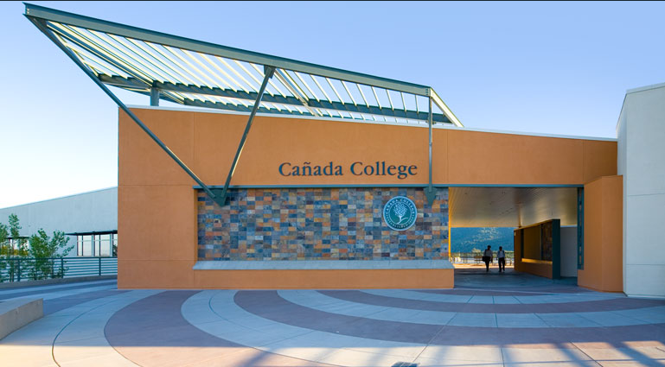
Cañada College Sustainability Plan - Update
Sustainability Committee
Vision & Goals
Programs/Status
www.canadacollege.edu/sustainabilitycommittee

Slide 2
Environmental Sustainability Committee
Susan Mahoney (Chair) – Faculty, Earth & Environmental Sciences
John Hashizume - Manager, Facilities Operations
Lisa Palmer – Faculty, English
Peggy Perruccio – Faculty, Fashion Design
Vacant Seat - Faculty
Jai Kumar - Manger, Bookstore
Krystal Johnson - Office Assistant, Disability Resource Center
Dr. Janet Stringer - Dean , Science and Technology Division
Jennifer Fitzgerald, Student
2

Slide 3
Cañada College Sustainability Vision
“Cañada College will be a model for environmental sustainability, inspiring and empowering our community to implement sustainable practices and promote social equity.”
3

Slide 4
Cañada College Sustainability Plan Goals
Campus and Community Awareness & Involvement
Curriculum Development
The Built Environment
Energy Conservation and Efficiency
Water Conservation and Efficiency
Solid Waste Management
Transportation
Sustainable Procurement
Renewable Energy and Onsite Generation
Climate Action Plan
Sustainability Plan Management

Slide 5
Goal Example

Slide 6
We were ambitious and we are making progress!

Slide 7
Highlights

Slide 8
Campus & Community Awareness & Involvement
Water Conservation Awareness: ongoing
EV Charging Station Event: 10-28-13
PV Groundbreaking Event: 4-10-14
Earth Day Event: 4-22-14
Lots more to do!
Sustainability website
Interpretive signage on all new projects
Behavioral reminders and educational info
New student, staff, faculty orientation
Increased student involvement !

Slide 9
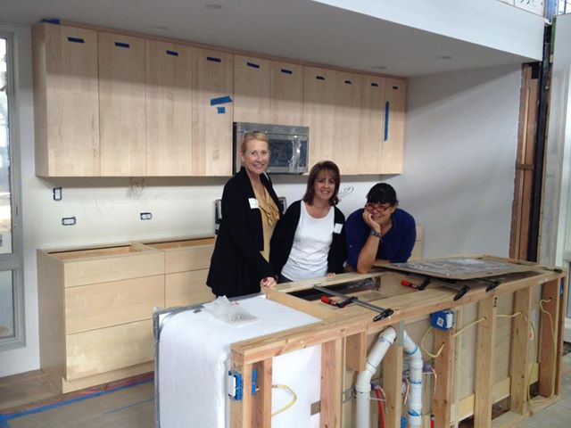
Curriculum Development
Sustainable Interior Design courses and certificate
Recycling and Resource Management certificate
Green Entrepreneurship short courses
Environmental Science GE course
Contextualized English courses
Student internships/training
Student research
Lots more to do!
Environmental Science major
Campus projects as part of the curriculum
Events and speakers

Slide 10
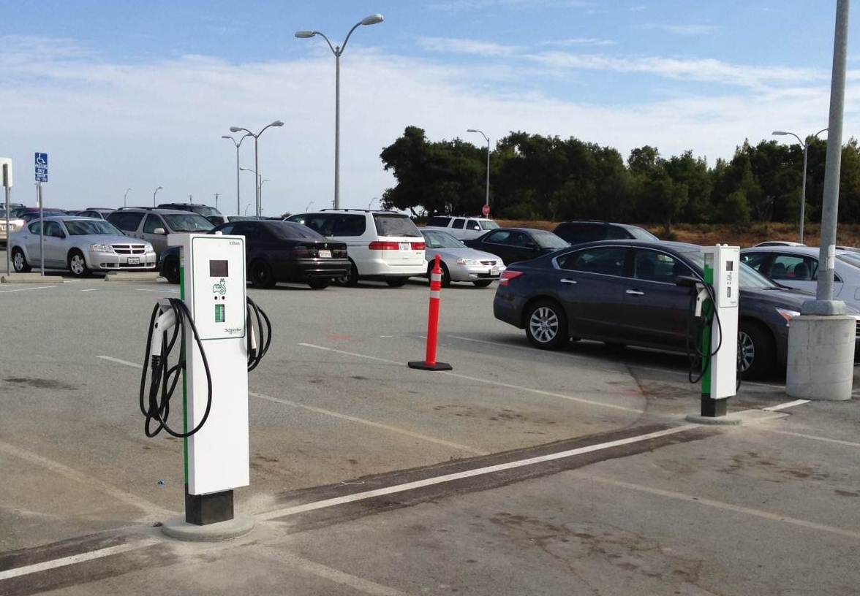
Energy Conservation & Efficiency
Energy audit
Electric vehicle charging stations
Lots more to do!
LED –exterior lighting
Theater lighting
Sub-metering project
LED – interior lighting

Slide 11
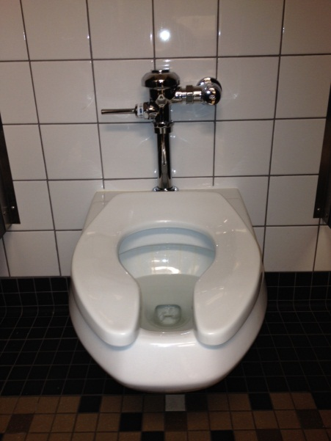
Water Conservation & Efficiency
Baseline established
Goals set (reduce by 25%) and exceeded
Announcements and signage to promote awareness
Training for facilities staff
Irrigation scheduling
Water bottle filling stations
Lots more to do!
Educational signage
Water metering
Sewage discharge monitoring

Slide 12
Solid Waste Management
Onsite mulching of green waste for soil amendments
Garbage and recycling bin placement improvements
Water bottle filling station
Lots more to do!
Establish waste baseline
Composting?
Bin placement study
Recycling education, signage and outreach
Procurement plan

Slide 13
Transportation
Electric vehicle charging stations
Distance Education
Lots more to do!!
Transportation study/survey
Carpooling and public transit incentives

Slide 14
Renewable Energy and Onsite Generation
1 MW Photovoltaic Project - in progress !

Slide 15
Our Strengths, Next Steps, and Our Needs
Strengths:
College and District Commitment
Momentum
Next
Campus Awareness/Involvement
Curriculum
Solid Waste
Need
More time and people-power!
More student involvement

