Slide 1



Mission
Undocumented Student Success
Supporting Our Undocumented Student Community
Cañada College Town Hall
May 8, 2020
Notes:
Saúl

Slide 2

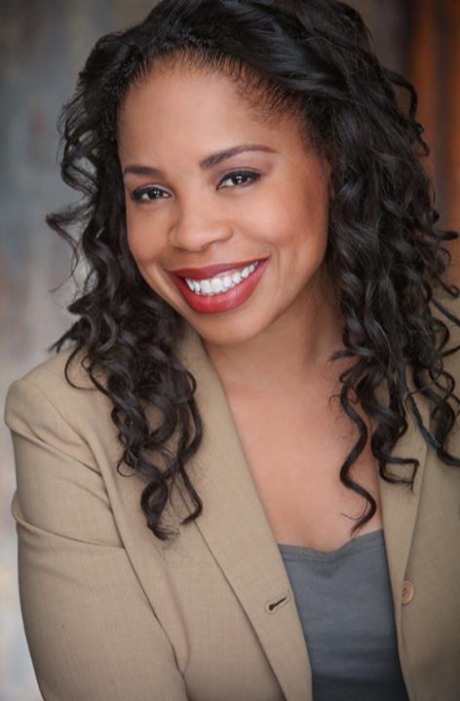
You Will Learn
Welcome!
Dr. Jamillah Moore
President
Cañada College
Notes:
President Jamillah Moore
This Town Hall will provide resources to support our undocumented student community at Cañada College.
Specifically, our Dream Center staff and Dreamers Task Force will share critical information and important resources that all faculty and staff can share with your offices, programs, and students about support for the undocumented community in the time of COVID-19.
DREAMers have a right to an Education
We have a professional responsibility to support DREAMers
We are providing Resources and Services
Need more info, contact us
Encourage to share this information
DREAMers are our Students also
Solidarity Statement: I ask you all to continue supporting Undocumented Students by sharing this information to your student list and guiding them to the Dream Center for further assistance. If they share their status, please do not share their personal information.

Slide 3
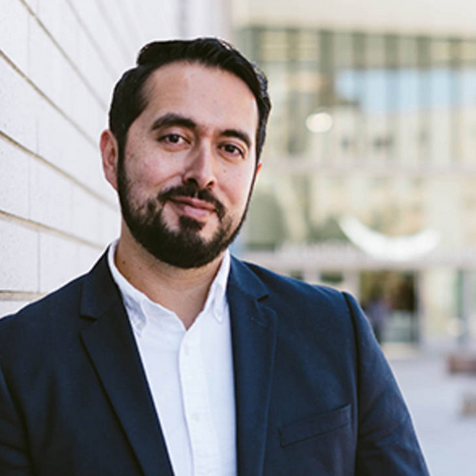
You Will Learn
Nuestra Communidad
Dr. Manuel Alejandro Pérez
Vice President, Student Services
Cañada College
Notes:
VPSS Manuel Alejandro Pérez

Slide 4
You Will Learn
Nuestra Communidad
Critical Information
Timely Resources
The Challenges
These Resources are Needed
Notes:
VPSS Manuel Alejandro Pérez
Critical Information
Timely Resources
The Challenges
These Resources are Needed

Slide 5
You Will Learn
Poll Question #1: Understanding Challenges…
I understand the challenges facing undocumented students (that would cause them to drop a class.)
Please respond using a scale of 1-5.
(1 = not at all comfortable, 5 = extremely comfortable)
Notes:
VPSS Manuel Alejandro Pérez
5 - HK poll Q’s
Replace first bullet point?- I understand the challenges an Undocumented Students face that would cause them to drop a class.

Slide 6
You Will Learn
Poll Question #2: Finding Resources…
I know where to find resources for
Undocumented students
Please respond using a scale of 1-5.
(1 = not at all comfortable, 5 = extremely comfortable)
Notes:
VPSS Manuel Alejandro Pérez
5 - HK poll Q’s
Replace first bullet point?- I understand the challenges an Undocumented Students face that would cause them to drop a class.

Slide 7
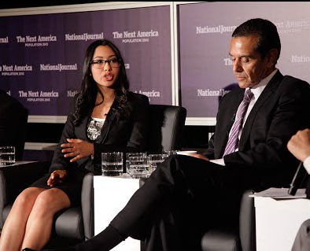

You Will Learn
An Undocumented Student’s College Opportunity
Dreamers Roadmap
A free national mobile app that helps undocumented students find scholarships to go to college.
Sarahi Espinoza Salamanca
Founder and CEO, DREAMers RoadMap
Notes:
Manuel

Slide 8
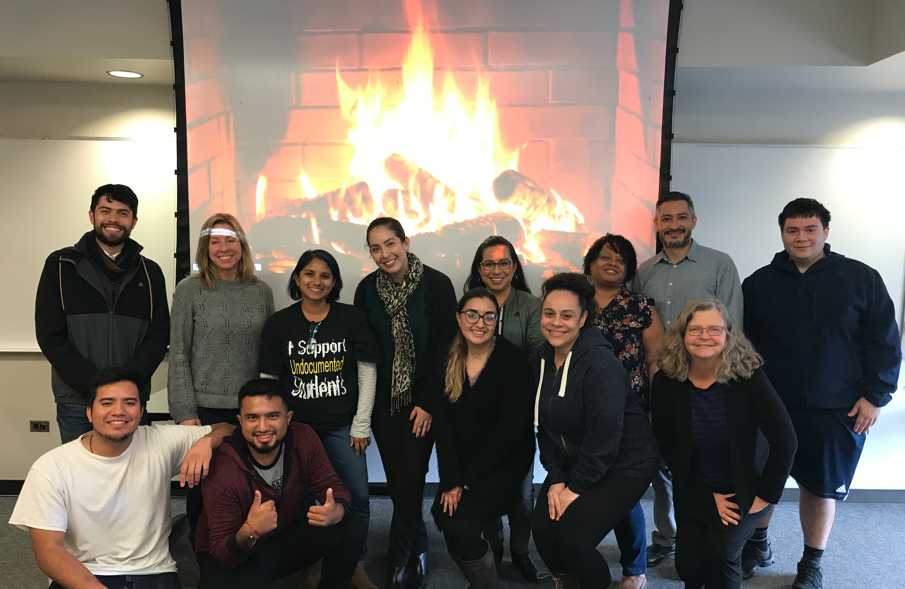
You Will Learn
A Student’s Perspective
Jeison Velasquez
President
Cañada College DREAMers Club
Notes:
Professor Alison Field
Please tell us about yourself
El Salvador
13 years ago
Majoring in Biology
Goal of transferring to UCLA or UCD in 2020
Why did you select Cañada College?
What Challenges have you seen Undocumented Students Face?
What resources would be helpful for Undocumented Students?

Slide 9
You Will Learn
(Undocumented) Student Challenges*
Students have stopped paying for anything but food.
Students are finding hourly work stocking shelves, working in nursing homes; they often do not feel their safety is a priority at their job.
Students are questioning more than ever whether to stay in the U.S.
or go back to their countries.
Support for undocumented students is limited and students don’t know how to access it “I need resources, not links.”
* Provided by Professor Julie Carey
Notes:
Professor Alison Field
Overarching challenges that students express
7 - HK student speakers/ testimonials - Dreamers Club -
/ Can Maria H. talk about UB students’ experience
Students that express the undocumented experience
Jeison then Maria H.
(Speaking to Maria tomorrow)
One student recently found work in a nursing home where two patients have died of COVID-19.

Slide 10
You Will Learn
(Undocumented) Student Resilience*
School still is a key priority for many immigrant students 😊 I have seen some of the best essays of my career coming in. Amazing what students can do when they have time!
The resilience, persistence, appreciation and community within my classrooms of immigrant students has been an inspiration for me. If they can do, I can do it!
* Provided by Professor Julie Carey
Notes:
Professor Alison Field
Overarching challenges that students express
7 - HK student speakers/ testimonials - Dreamers Club -
/ Can Maria H. talk about UB students’ experience
Students that express the undocumented experience
Jeison then Maria H.
(Speaking to Maria tomorrow)

Slide 11
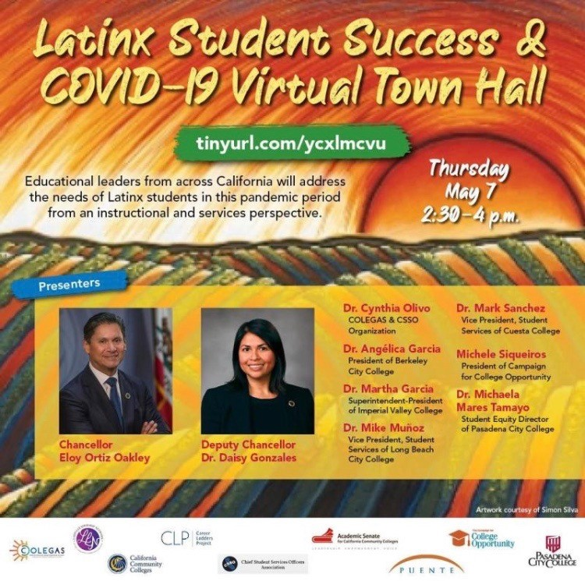
You Will Learn
Latinx Student Success & COVID 19 Town Hall Recap
Challenges
Disproportionate impact, high exposure, multigenerational households
Solutions
Safety, Stability, and Support
Notes:
Nimsi Garcia

Slide 12
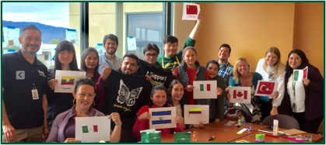
You Will Learn
Undocumented Student Allies & Champions
Students - Dreamers, Undocumented Students, and DACA Recipients
                DREAMers Club
Dream Center
Cañada College
DREAMers Task Force
Cañada College
Community Partners
Notes:
Saúl Miranda - Critical information
This is how we support Undocumented Students
Students to
The portals
This was a committee that
Throughout
Champions on campus
Well invested Community Partners
Questions
Who are our students?
Where do we find allies?
How important are community partners?
We have an impact
Collective impact, WE Support Undocumented Students.
Explain the importance of the Support System
Job (income)
Bills
Family Structure (children, no privacy)
Boys & Girls (cultural, how they are treated)
Outline
Dream Center (Saúl)
Task Force
SMCCD Dream Center Task Force (Pamala, Jackie, Griselda, Adolfo, Saúl)
Aligning services & sharing best practices/concerns
DREAMers Task Force (Canada College)
DREAMers Club (Julie and Saúl) Jeison & Lalo
Message:
Even though COVID-19 has encouraged us to go remote, The Dream Centers continues to provides key services for Undocumented Students, still being a one-stop-shop from receiving resources, learning about campus services, and providing guidance.
The DREAMers Task Force are meeting by Zoom, Come join Us
In addition, SMCCD Dream Center Task Force having bi-weekly meetings to align services, sharing practices/concerns, and planning projects.
As DREAMers Club President, Jeison,

Slide 13
Campus Resources

Slide 14
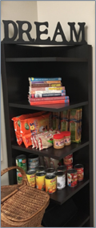
You Will Learn
From Outreach to Completion
Outreach / Admissions – Mayra Arellano
Financial Aid – Luanne Canestro
Counseling – Nadya Sigona
Transfer/Degree/Certificate – Nadya Sigona
Student Support – Diva Ward
Notes:
Saúl MIranda
10 - HK speakers for slides - missing academics
Saúl - Critical information
Champions on campus
Well invested Community Partners
Each stage of Undocumented Students
Registering
This is not critical
Set the stage that we
Questions
Who are our students?
Where do we find allies?
How important are community partners?
We have an impact
Collective impact, WE Support Undocumented Students.
Explain the importance of the Support System
Job (income)
Bills
Family Structure (children, no privacy)
Boys & Girls (cultural, how they are treated)
Outline
Dream Center (Saúl)
Task Force
SMCCD Dream Center Task Force (Pamala, Jackie, Griselda, Adolfo, Saúl)
Aligning services & sharing best practices/concerns
DREAMers Task Force (Canada College)
DREAMers Club (Julie and Saúl) Jeison & Lalo
Message:
Even though COVID-19 has encouraged us to go remote, The Dream Centers continues to provides key services for Undocumented Students, still being a one-stop-shop from receiving resources, learning about campus services, and providing guidance.
The DREAMers Task Force are meeting by Zoom, Come join Us
In addition, SMCCD Dream Center Task Force having bi-weekly meetings to align services, sharing practices/concerns, and planning projects.
As DREAMers Club President, Jeison,

Slide 15
You Will Learn
Outreach Support for Undocumented Students
  Constant Communication with Community and H.S. Partners
  Application Workshop via Zoom
                One-on-One appointments to support the matriculation process
  Orientation via PEPS
  Matriculation Documents, Spanish translation
  Connect to College (English & Spanish)
  Looking Forward: High School Transition Plan
Notes:
Mayra Arellano
Mayra - Outreach
What are some challenges Undocumented Students are facing with registration?
Why is it important to have Spanish language assistance during matriculation?
How have you shifted services to support Undocumented Students?
Now speaking Mayra Arellano, sharing information about Outreach.
Connect to College: We are going to have an Open House Thursday, May 14th. Planning to connect with Undocumented Students. Weekly communication with High School counselors, updating information.
Diva - Learning Center
What are Undocumented Students having challenges with? (Course Retention)
How is the Learning Center supporting Undocumented Students to stay in their classes?
What resources are being provided?

Slide 16
You Will Learn
Financial Aid Support for Undocumented Students
There is financial support for Undocumented Students.
Students can apply year-round for the CCPG*, but there are deadlines for the Cal Grants.
                Students must reapply each year.
Don’t complete the FAFSA – this form is for federal financial aid eligible students.
  Contact: canadafinancialaid@smccd.edu
  * California College Promise Grant (CCPG) – formerly the BOG Fee Waiver
Notes:
Luanne Canestro
Luanne:
What is the CA Dream Act?
Does the CA Dream Act applicant receive the same F.A. package amount ($$$) as a FAFSA FA applicant?
Since Undocumented Students are categorized as International Students, what is the Cost for attendance?
Why is financial aid important for Undocumented Students?
What is the Financial Aid office doing to support Undocumented Students?
Are there other financial supports (Scholarships and/or programs) that could help with the cost?

Slide 17
You Will Learn
Academic Counseling Support
We are still open!
Counseling allows students to explore their options
                Students don’t think they can transfer, but they can
The sky is the limit.
They can transfer and obtain scholarships. ”Si se Puede!”
Contact Welcome Center : (650) 306-3452
Notes:
Nadya Sigona
13 - HK Counseling (Nadya) (She has Confirmed)
To explore their options - They don’t think they can transfer, but they can… there are resources at the CSU’s and UC’s… pages of information.
Sky is the limit.. They can transfer, scholarships… not impossible. Able to do.
Resources would depend on my goal… options you can have, after grad… jobs that you an do.. Some majors that they may be able to work.
What if I don’t have the money?

Slide 18
You Will Learn
Transfer/Completion Support
for Undocumented Students
Student goals determine resources
Options and jobs you can have after graduation
University resources
There are resources at the CSU’s and UC’s
allies at other institutions for warm handoff + referrals.
Options for non- transfer / Career Education / own business
Notes:
Nadya Sigona
Same options for undocumented
Establishing trust - student connections -
University resources. - allies at other institutions for hand holding + referrals.
Options for non- transfer / CE / own business
Dreamers resources
Options

Slide 19

You Will Learn
Student Support for Undocumented Students
  Learning Center Newsletter
  Peer Mentor & Counseling
  Tutoring Sessions
  Virtual Summer Session
  Learning Center Office Hours
  Retention Support
Notes:
Diva Ward
14 - HK student support
ID additional services for Undocumented students
Mayra - Outreach
What are some challenges Undocumented Students are facing with registration?
Why is it important to have Spanish language assistance during matriculation?
How have you shifted services to support Undocumented Students?
Now speaking Mayra Arellano, sharing information about Outreach.
Connect to College: We are going to have an Open House Thursday, May 14th. Planning to connect with Undocumented Students. Weekly communication with High School counselors, updating information.
Diva - Learning Center
What are Undocumented Students having challenges with? (Course Retention)
How is the Learning Center supporting Undocumented Students to stay in their classes?
What resources are being provided?

Slide 20
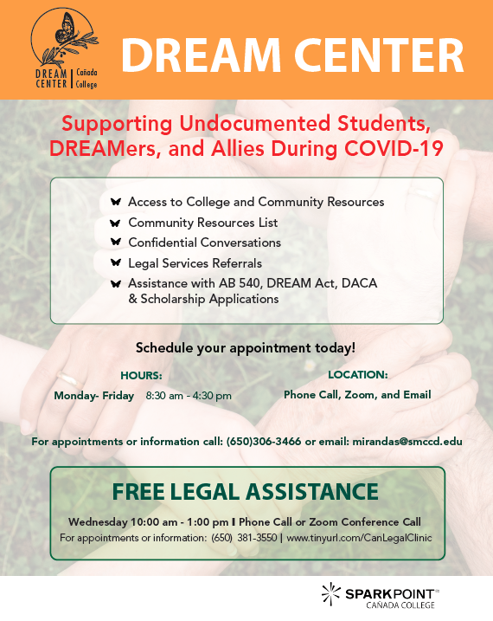
You Will Learn
Dream Center at Cañada College
Basic Needs Resource List
Confidential Conversation
Free Legal Clinic - Spanish Language Translations
DACA Renewal Resources
Dream Center Question Intake Form
Website: canadacollege.edu/dreamers
Notes:
Saúl Miranda
Resource list: simplify and focus on essentials resources
Confidential Conversation: share their concerns and give referrals to services.
Free Legal Clinic: Available and provides Spanish language translations
DACA Renewals: Top concern, Share resources with DACA recipients
DC Question Form: anonymously, or not, ask questions

Slide 21
You Will Learn
Food Resources
Food Grant Program
Emergency Food Distribution (at CSM)
Referrals - Core Agencies, 211, Food Connection
SparkPoint: Financial Coaching
CalFresh - (mixed status households)
up to $194/mo. per eligible family member
Notes:
Adolfo Leiva
BOT has approved $1 Grant to address Food Insecurities
Emergency Food Distribution – 4100 families
COVID-19 – referrals
SparkPoint – Cañada Cash, Budgeting, Savings, Credit Building
CalFresh – Mixted status families

Slide 22
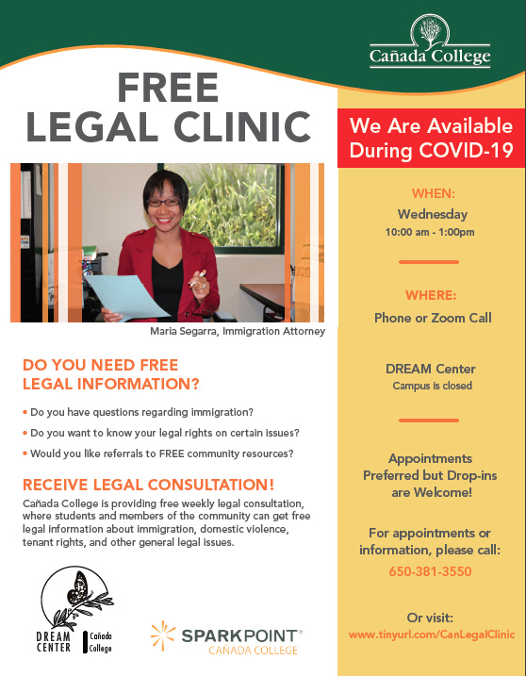
You Will Learn
Cañada College Free Legal Clinic
Attorney Maria Segarra Gaudio
Available during COVID-19
Free, confidential and tri-lingual
Open to students and the community
Immigration, domestic violence, tenant rights & general legal issues
Notes:
Adolfo Leiva

Slide 23
You Will Learn
COVID-19 Legal Impacts for Undocumented Students
Growing concerns: (un)employment & domestic violence
Don’t apply for Unemployment Insurance (UI) or CalFresh if you’re not using your SSN.
    Fraud, ID Theft, extends processing time & impacts citizenship process
    Labor exploitation – Seek out workers rights
Notes:
Adolfo Leiva

Slide 24
You Will Learn
Supporting Undocu Well-being:
Cañada College Wellness Center
Personal Counseling Center: https://canadacollege.edu/PCC/
Health Center: https://canadacollege.edu/healthcenter/
Disability Resource Center: https://canadacollege.edu/disabilityresourcecenter/
Notes:
Manuel Alejandro Perez
20 - HK student services

Slide 25
Community Resources

Slide 26
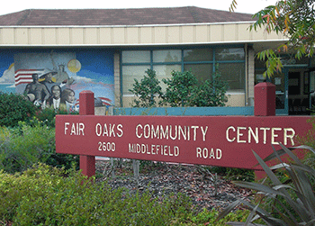
You Will Learn
Fair Oaks Community Center :
2600 Middlefield Rd. Redwood City
The Fair Oaks Community Center is a multi-service facility offering a variety of services to the broader Redwood City Community.
Child care and pre-school, crisis intervention, classes including ESL/citizenship, exercise, art, computers, food programs, shelter referrals, housing assistance, deposit and rental assistance, immigration and citizenship assistance, and legal services.
Notes:
Anna Avendaño
22 - HK FOCC Talking Points

Slide 27

You Will Learn
Fair Oaks Community Center :
Service Highlights
Emergency Food Resources & Shelter Referrals and Rental Assistance program - Fair Oaks Community Center
  (650-780-7500)
Immigration Institute of the Bay Area
  (650-780-7530)
Peninsula Family Service
  (650-780-7542)
RWC Child Development Center
  (650-780-7520)
Notes:
Anna Avendaño
22 - HK FOCC Talking Points

Slide 28
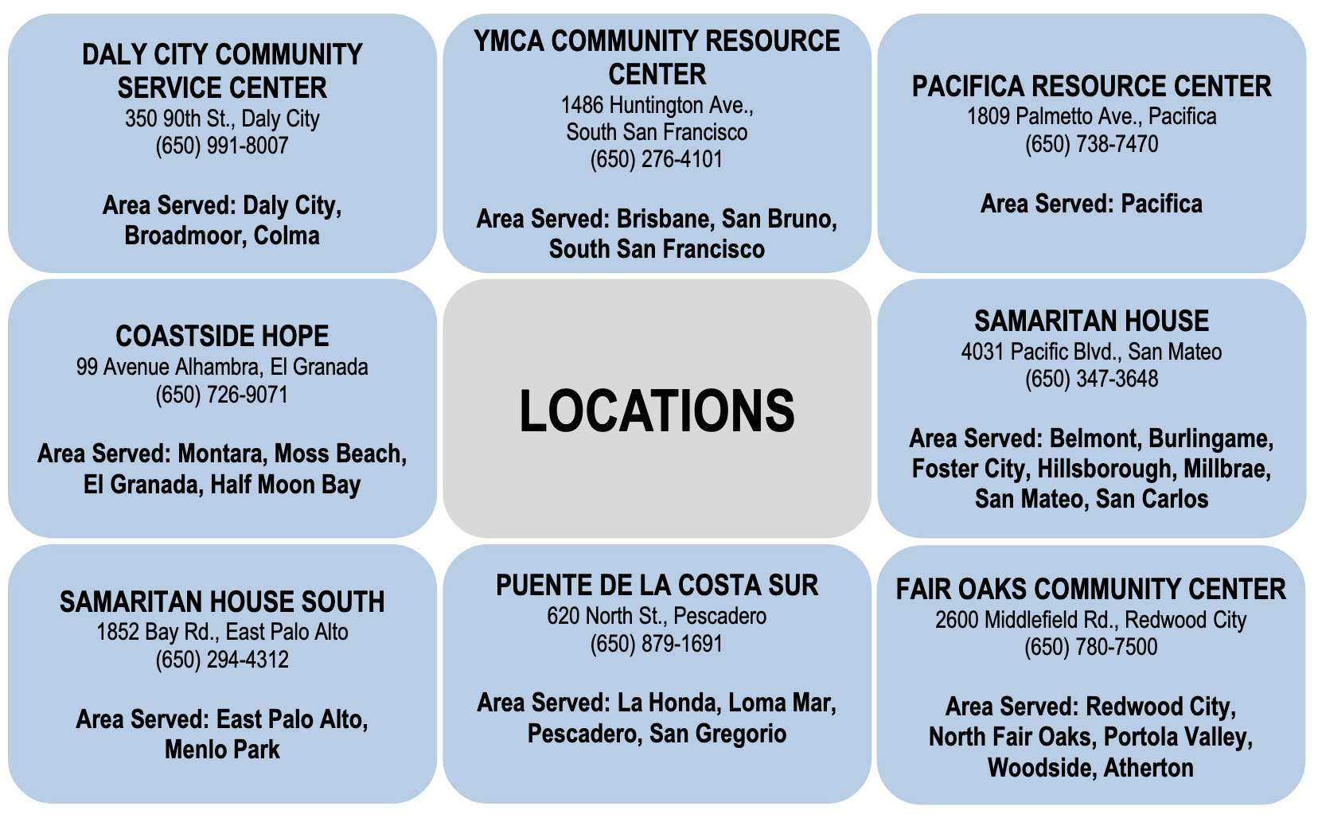
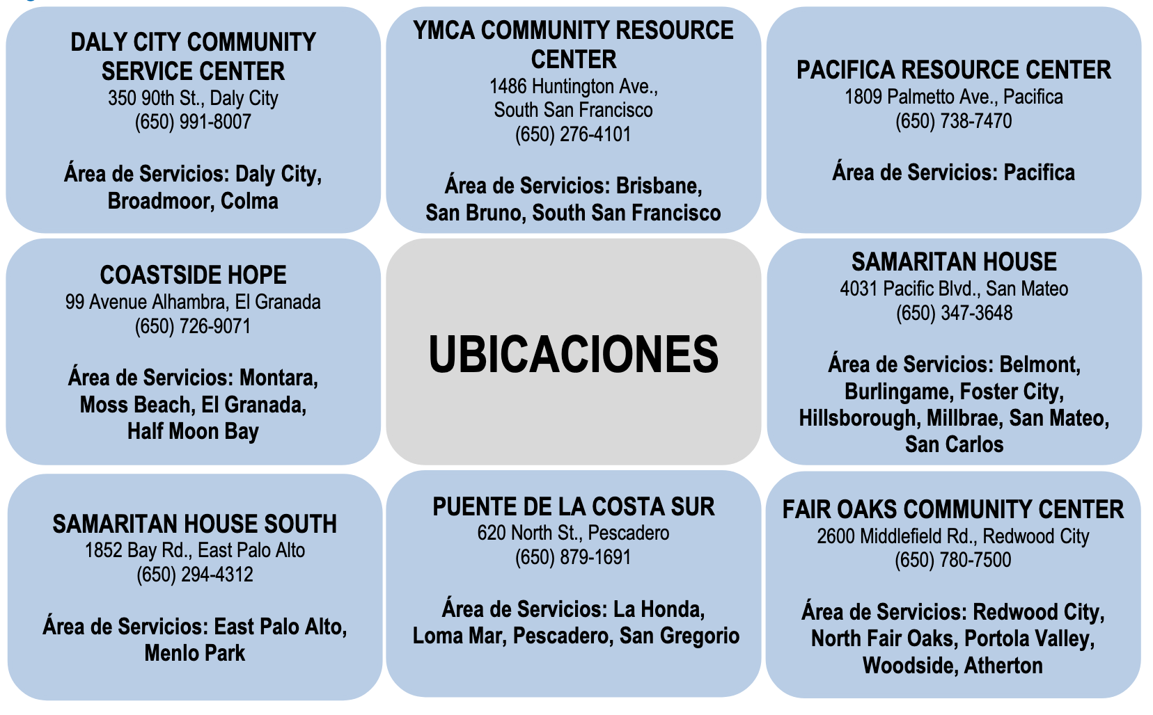
You Will Learn
San Mateo County Core Agencies
Notes:
Anna Avendaño
22 - HK FOCC Talking Points

Slide 29
You Will Learn
Community Food Resources
Need Bagged Groceries?
Visit St. Francis Center
  151 Buckingham Ave. / M-F, 10:30am - 1:30pm
Need a Free Meal?
Visit Redwood City Boys & Girls Club for Free Dinner
  1109 Hilton St. / M-F, 6pm - 7pm
Need a Bagged Lunch?
Visit Padua Dining Room for Bagged Lunch
  3500 Middlefield Rd. / M-Sat, 11am - 1pm
Notes:
Anna Avendaño
23 - HK talking points with Rafael

Slide 30


You Will Learn
Community Legal & Health Services
Catholic Charities
  Legal Assistance by Zoom or Phone Call Appointments
  DACA Renewals, Immigration, Housing & Homelessness, Children Services, Aging Support Services
Legal Aid Society of San Mateo County
  Legal Assistance by Zoom or Phone Call Appointments
  Immigration, Housing, Health Care, Domestic Violence Survivor Support
Notes:
Saúl
24 - HK Poll Q

Slide 31
You Will Learn
Poll Question #1: Understanding Challenges…
I understand the challenges facing undocumented students face that would cause them to drop a class.
Please respond using a scale of 1-5.
(1 = not at all comfortable, 5 = extremely comfortable)
Notes:
Manuel
5 - HK poll Q’s
Replace first bullet point?- I understand the challenges an Undocumented Students face that would cause them to drop a class.

Slide 32
You Will Learn
Poll Question #2: Finding Resources…
I know where to find resources for
Undocumented students
Please respond using a scale of 1-5.
(1 = not at all comfortable, 5 = extremely comfortable)
Notes:
Saúl Miranda / Adolfo Leiva
5 - HK poll Q’s
Replace first bullet point?- I understand the challenges an Undocumented Students face that would cause them to drop a class.

Slide 33
Summary
Questions and Answers
Thank you!

Slide 34
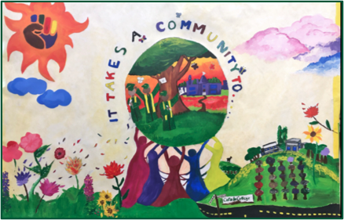
You Will Learn
How to Contact Us
Saul Miranda
Program Services Coordinator
Dream Center
mirandas@smccd.edu
650-306-3466
canadacollege.edu/dreamers
* Confidential Conversations *
Notes:
Saúl Miranda / Adolfo Leiva
Campus Leadership – JM + AP for the venue + support
Dreamers Task Force – unwayvering commitment
Panelists – Dedication and passion
Staff and Faculty -
Attendees – wanting to learn more about supporting
Students – for being resilient and brave
I want to confirm the panelist:
Saúl Miranda - mirandas@smccd.edu
Nimsi Gracia - garcian@smccd.edu
Adolfo Leiva - leivaa@smccd.edu
Kiran Malavade - malavadek@smccd.edu
Mayra Arellano - arellanom@smccd.edu
Luanna Canestro - canestrol@smccd.edu
Nadya Sigona - sigonan@smccd.edu
VPSS Manuel A. Perez - perezma@smccd.edu
President Jamillah Moore - moorej@smccd.edu
Maria Huning - huningm@smccd.edu
Alison Field - fields@smccd.edu
Jeison Velasquez - garridostivell10@gmail.com
Ana Avendaño - aavendano@redwoodcity.org
Rafael Avendaño - raavendano@yahoo.com

