Slide 1

Educational Master Planning Retreat
March 11, 2022
EMP Task Force

Slide 2
Welcome & Introductions

Slide 4
EMP Retreat Objectives
Discuss and refine Goal Statements
Discuss and refine Strategic Initiatives (key actions we will take to achieve each goal)
Learn about the Facilities Master Planning recommendations
Identify the remaining work to be done to complete a first draft of our EMP

Slide 5
Educational Master Planning Process & Timeline
PBC names EMP Task Force Members
EMP Task Force evaluates 2017-22 EMP
SCUP Training in Strategic Planning
Mission, Vision, Values Update
Cañada Educational Master Plan Timeline
EMP TF considers “Internal Scan”
EMP TF considers “External Scan”
College Councils provide input on challenges and opportunities
Town Hall
Winter 2021
Spring 2021
September 2021
October 2021
EMP Retreat: Set goals and new strategies
Campus constituents provide input on draft EMP
PBC considers draft EMP
PBC adopts new EMP for 2022-27
October 2021
November 2021
December 2021
February 2022
February 2022
March 2022
April 2022
May 2022

Slide 6
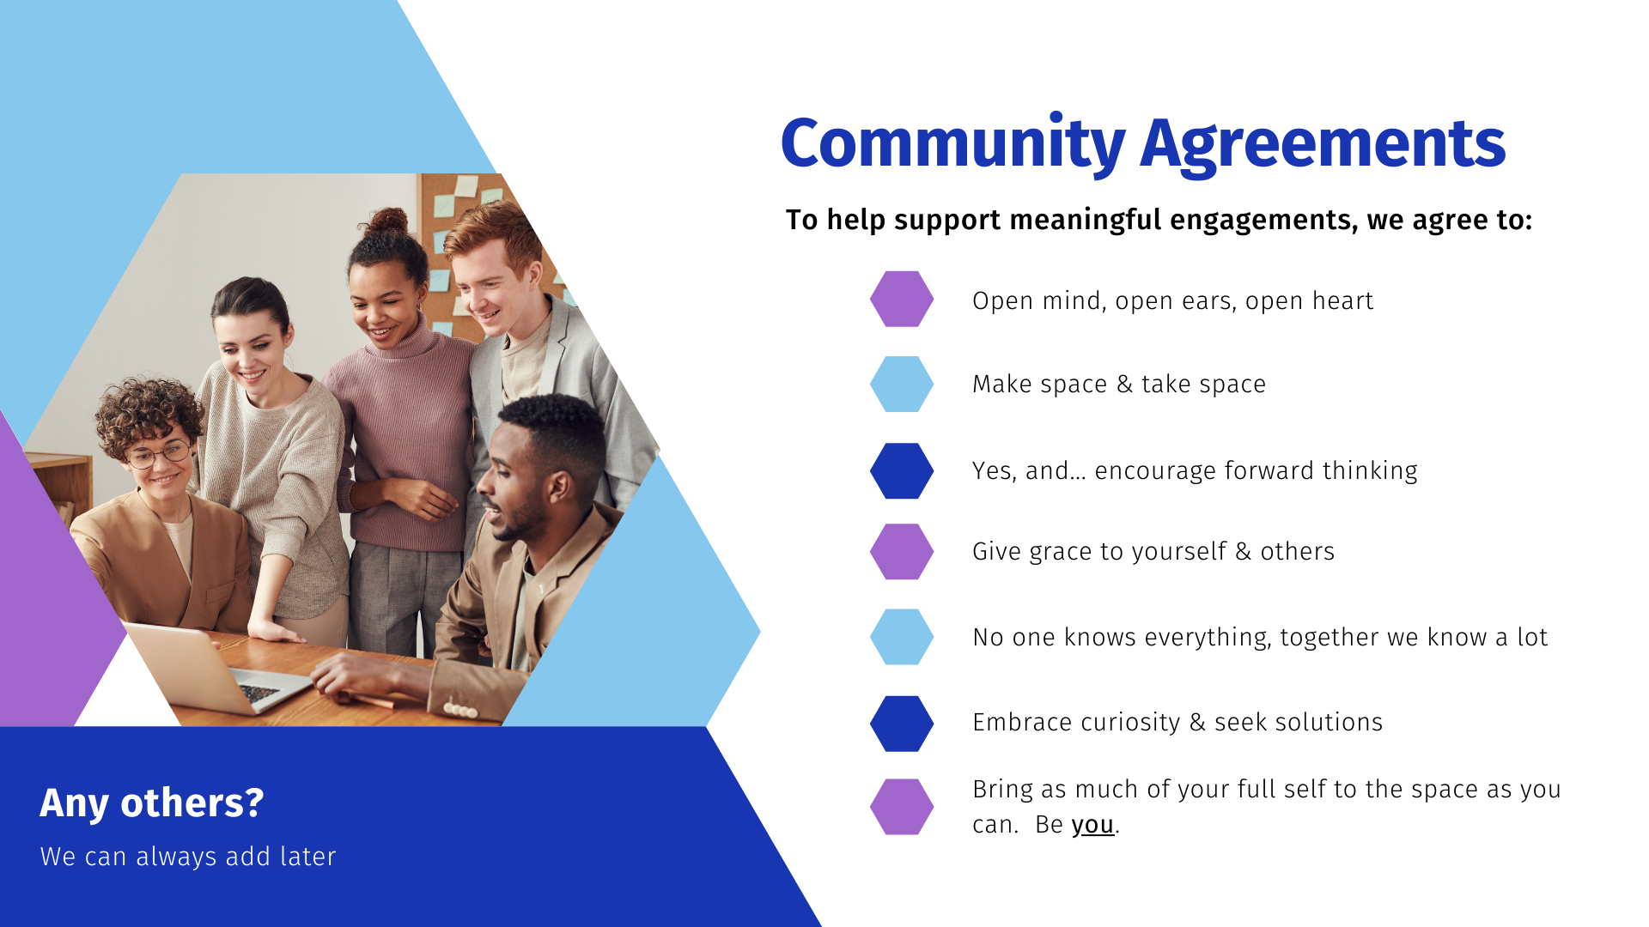
By Dr. Lauren Ford & Dr. Denicia Carly

Slide 7
Review Work To Date - website
Draft Goal Statements for Review
Draft Strategic Initiatives for Review
Strategy Inventory
  Existing EMP, District Strategic Plan, other plans and documents

Slide 8
Modify Draft Goal Statements
SCUP Review (brief)
Develop 1-3 draft versions of your group’s goal statement and prepare to share out
Share Out

Slide 9
SCUP: Goals, Strategies and Tactics
Goal: | A broad, general statement of intended outcomes or results
Strategy: | A plan of action created to achieve a goal or a vision or to address a strategic issue
Tactic: | A specific action an institution takes to carry out a strategy

Slide 10
SCUP: Goals, Strategies and Tactics
Goal: | A broad, general statement of intended outcomes or results
Strategy: | A plan of action created to achieve a goal or a vision or to address a strategic issue
Tactic: | A specific action an institution takes to carry out a strategy
This gets addressed on an annual basis. Each year, we develop tactics during our Summer Leadership Retreat. These form the basis for our Annual (operational) Plan.

Slide 11
Goals and Strategies
Goal: | A broad, general statement of intended outcomes or results
Strategy: | A plan of action created to achieve a goal or a vision or to address a strategic issue

Slide 12
Goals and Strategies
Goal: | A broad, general statement of intended outcomes or results
Strategy: | A plan of action created to achieve a goal or a vision or to address a strategic issue
Goals are WHAT
Strategies and tactics are HOW

Slide 13
Writing GOAL Statements:
Return to Strategic Issues (challenge/opportunity)
The easiest and most beneficial way to determine your goals is to return to your strategic issues. You can ask the following for each issue:
If we resolved this strategic issue, what outcomes would we see?
What benefits would we see?

Slide 14
Writing GOAL Statements:
Phrase Goals as Results, Not Actions
Goals written as outcomes leave room for stakeholders to come up with ideas on how to contribute to the goal.
They are more inspirational.

Slide 15
Two Tips for Writing Goals that are not Strategies:
Think about phrasing your goals as “states of being” not actions.
Phrase your goals as results.

Slide 16
SMART(E) Goals
Specific: clearly define the intended outcome
Measurable: the goal can be quantified
Assignable: a person, department or committee could be given responsibility for the goal
Realistic: It can be achieve with an institution’s resources and in the amount of time indicated
Timebound: identifies when the goal will be completed
Equity-minded: addresses the college’s obligation to close equity gaps in student outcomes and address bias in college culture and climate

Slide 17
Goals from our last EMP
  Student Completion/Success
Provide educational and student services programs that highlight inclusivity, diversity, and equity in their mission to help students meet their unique educational goals and minimize logistical and financial barriers to success.
  Community Connections
Build and strengthen collaborative relationships and partnerships that support the needs of, reflect, and enrich our diverse and vibrant local community.
  Organizational Development
Focus institutional resources on the structures, processes, and practices that invest in a diverse student population and prioritize and promote equitable, inclusive, and transformative learning.

Slide 18
Proposed revised goal headings
Student Completion/Success
Community Connections
Equity-minded and Antiracist Organizational Development
Accessible Infrastructure and Innovation

