Slide 1
College Opening Session: President’s Welcome, Guided Pathways Update, and Educational Master Planning
October 13, 2021
FLEX DAY

Slide 2
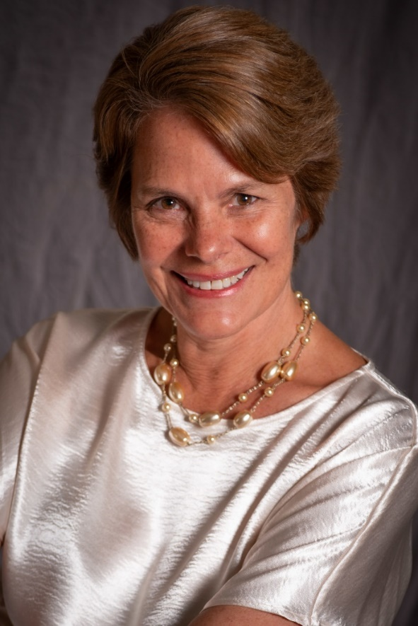
Welcome!
Kim Lopez
Interim President
Cañada College

Slide 3
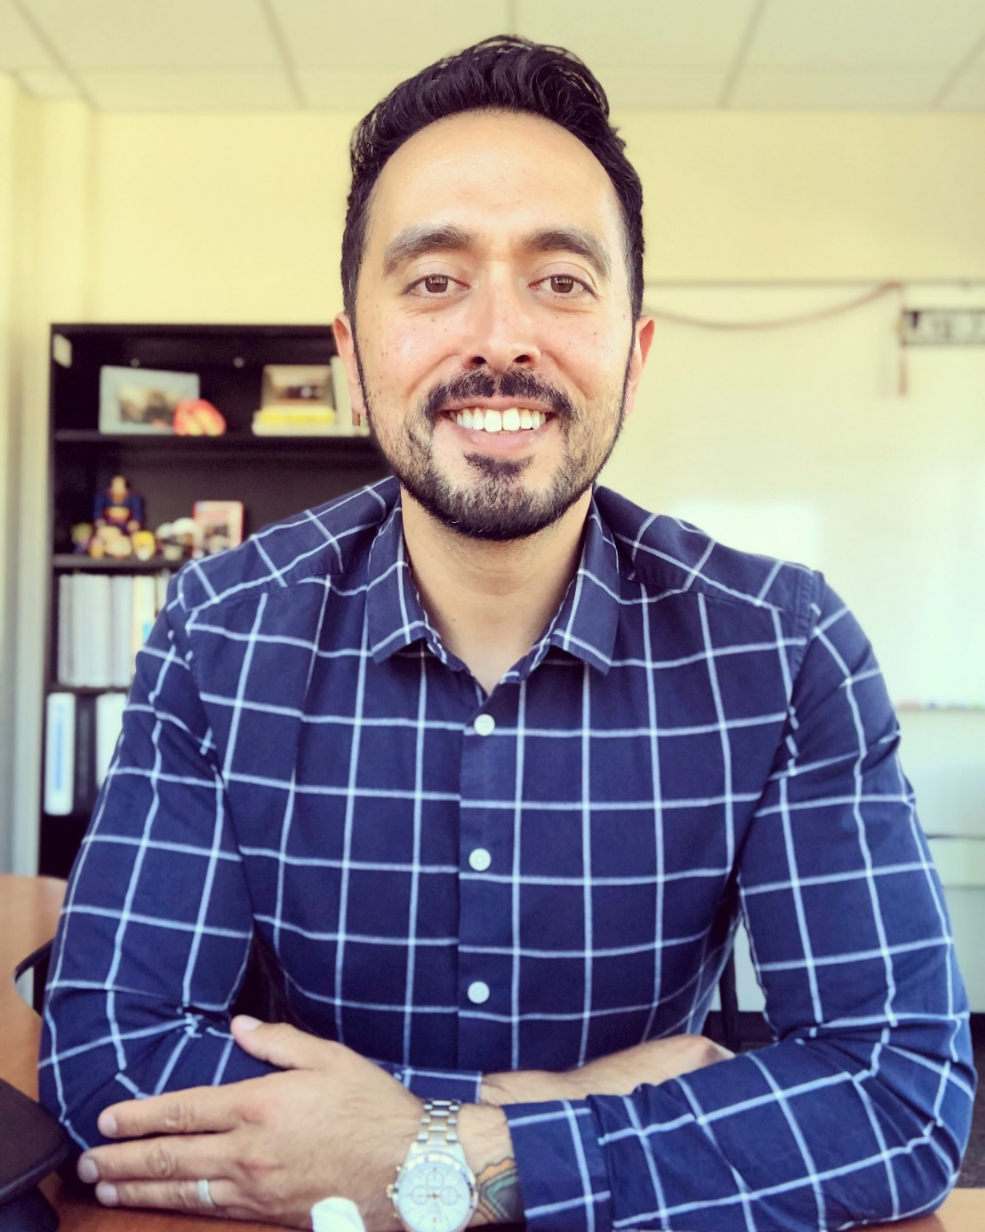
Guided Pathways Update
Manuel Alejandro Pérez Vice President of Student Services

Slide 4
Guided Pathways Update
Staffing Update
Retention Specialists:
Gonzalo Arrizon – Science and Health
Diana Espinoza-Osuna – Human Behavior and Culture
Melissa Maldonado – Business
TBD (posted) – Art, Design and Performance
Assistant Director for Guided Pathways: Margarita Baez
Director for Student Support: posted position
Priorities for the Year
Success Teams
First Year Experience
Dual Enrollment
Career Exploration
Ensuring & Documenting Learning

Slide 5
Educational Master Planning Flex Day All-College Session
October 13, 2021
Facilitated by members of the Educational Master Planning Task Force

Slide 6
Welcome from the EMP Task Force!
Task Force Tri-Chairs:
David Eck, Academic Senate President
Roslind Young, Classified Senate President
Karen Engel, Dean of Planning, Research, Innovation & Effectiveness and Accreditation Liaison Officer
Faculty Members:
Humanities and Social Sciences Division Rep: Alicia Aguirre
Business, Design and Workforce Division Rep: Leonor Cabrera
Science and Technology Division Rep: TBD
Kinesiology, Athletics and Dance Division Rep: Eddy Harris
Counseling Division Rep: Jenna French
Classified Staff Representatives:
Outreach & Welcome Center Rep: Jeanne Stalker
Classified Rep At Large (and GP Success Teams): Nimsi Garcia
Transfer Services Rep: Mary Ho
Instructional Division Rep: Krystal Martinez
Instructional Technologist: Allison Hughes
Student Representatives:
Mira Rubio
Brittney Samora-Delgadillo
Administrators:
Dean of Business, Design & Workforce: Hyla Lacefield
Dean of Enrollment Services and Student Support: Wissem Bennani
Staff Support: The Office of Planning, Research & Institutional Effectiveness will provide staff support, research, analysis and writing throughout the process: Milena Angelova, Olisaemeka “Isaac” Chukwudebe, and Alex Claxton

Slide 7
Educational Master Planning Process & Timeline
PBC names EMP Task Force Members
EMP Task Force evaluates 2017-22 EMP
SCUP Training in Strategic Planning
Mission, Vision, Values Update
EMP TF considers “Internal Scan”
EMP TF considers “External Scan”
College Councils provide input on challenges and opportunities
Town Hall
Winter 2021
Spring 2021
September 2021
October 2021
EMP Retreat: Set goals and new strategies
Campus constituents provide input on draft EMP
PBC considers draft EMP
PBC adopts new EMP for 2022-27
October 2021
November 2021
December 2021
February 2022
February 2022
March 2022
April 2022
May 2022

Slide 8
Revisions to the District mission and vision proposed by the District Antiracism Council
Proposed Revised SMCCCD Mission
The mission of the San Mateo County Community College District is to achieve racial equity and economic justice in teaching, learning, and workforce development in order to strengthen the vitality and health of the communities we serve.
Proposed Revised SMCCCD Vision
The San Mateo County Community College District strives to create truly liberatory educational experiences for all members of San Mateo County communities to flourish by eradicating institutional racist policies and practices.

Slide 9
Revisions to the District values proposed by the District Antiracism Council
ANTIRACIST & JUSTICE-CENTERED COMMUNITY: We ensure that our culture and education is critical, transformative, and builds a District and campus community that resists individual and systemic anti-Blackness and racism. We are guided by theory and intellectual rigor to help us build towards an antiracist community. By centering antiracism and justice, we ensure that we root out ALL forms of oppression in our educational system.
TRANSFORMATIVE RESOURCE ALLOCATION: We commit to improve resource allocation decisions, systems, practices, and policies for Black, Indigenous, and People of Color (BIPOC) and our entire community. When we address these inequities all members of the community benefit. The district and college campuses commit to transformational decision making which seeks out multiple perspectives and provides space for voices that have been historically silenced. We do this by creating a culture that uplifts and centers the voices and experiential knowledge of our District and Campus communities, specifically the voices of groups that have been minoritized.
LIBERATORY PRACTICES FOR ECONOMIC HEALTH: We rebuild, strengthen, and implement, through a reimagining of our policies and practices, the resources and systems that support self-sufficient and self-actualized communities (building more free communities) through a critical exploration of the systemic impact of capitalism, patriarchy, and racism in our communities.

Slide 12
Mission Statements
Our College provides our community with a learning-centered environment, ensuring that all students have equitable opportunities to achieve their transfer, career education, and lifelong learning educational goals. The College cultivates in its students the ability to think critically and creatively, communicate effectively, reason quantitatively, and understand and appreciate different points of view within a diverse community.
To empower and transform a global community of learners.
Our College is committed to addressing the broad educational needs of the local and world community. We foster success and ensure equitable opportunities for all our students, while celebrating the diversity of our campus.

Slide 13
Vision Statements
Our College is committed to being a preeminent institution of learning, renowned for its quality of academic life, its diverse culture and practice of personal support and development, extraordinary student success, and its dynamic, innovative programs that prepare students for the university, the modern workplace, and the global community.
Our College inspires a global and diverse community of learners to achieve intellectual, cultural, social, economic and personal fulfillment.

Slide 14
Cañada Values:
Transforming Lives
High Academic Standards
Diverse and Inclusive Environment
Student Success in Achieving Educational Goals
Community, Education, and Industry Partnerships
Communication and Collaboration
Engaging Student Life
Accountability
Sustainability
Transparency

Slide 15
Skyline Values Statement:
Education is the foundation of our democratic society.
Thus:
Social Justice: We are committed to a comprehensive diversity framework that promotes social justice throughout all policies, procedures, and practices of the College.
Campus Climate: We value a campus-wide climate that reflects a ‘students first philosophy' with mutual respect between all constituencies and appreciation for diversity. Both instruction and student services are dedicated to providing every student with an avenue to success.
Open Access: We are committed to the availability of quality educational programs and services for every member of our community regardless of level of preparedness, socioeconomic status, gender, gender expression, sexual orientation, cultural, religious, or ethnic background, or disability status. We are committed to providing students with open access to programs and responsive student services both in person and online that enable them to advance steadily toward their goals.
Student Success and Equity: We value students’ success in achieving their goals, on time, and strengthening their voices as they transform their lives through their educational experience. We aim to identify and address equity gaps through evidence-based research to ensure that each student has the opportunity to succeed.
Academic Excellence: We value excellence in all aspects of our mission as a comprehensive community college offering preparation for transfer to a baccalaureate institution, workforce and economic development through career technical education programs and certificates, Associate of Arts and Associate of Science degrees, a Baccalaureate Degree, basic skills development, and lifelong learning. We are committed to academic rigor and quality with relevant, recent, and evolving curricula and well-equipped programs that include new and emerging areas of study. We are dedicated to an educational climate that values creativity, innovation and freedom of intellectual exploration, discovery, thought, and exchange of ideas.
Community Partnership: We value a deep engagement with the community we serve through collaborating with local school districts, industry, non-profits, government and the arts. Valuing our role as an academic and cultural center, we are dedicated to meeting the needs of the labor market and community.
Participatory Governance: We value just, fair, inclusive, and well understood, transparent governance processes based upon open and honest communication.
Sustainability: We value an institutional culture that is committed to environmental sustainability and justice. We are committed to the tenet of sustainability, “To meet present needs without compromising the ability of future generations to meet their needs.”

Slide 16
CSM Values Statement:
Equity
As a Hispanic Serving Institution, we are committed to creating a socially just campus climate wherein everybody is welcome and celebrated, and wherein everybody is an integral part of the campus. We believe that all students are entitled to a safe learning environment that celebrates their intersectional identities, fosters their agency, and develops their capacity for self-advocacy.
Academics
CSM takes great pride in its commitment to academic excellence. Our goal is to facilitate engaged, informed leadership and successful, satisfying careers for our students. We see our campus as a vibrant hub of intellectual rigor and relevance. As such, we embrace mindful learning, information literacy, and independent thinking to ensure a dynamic, innovative workforce and transfer population.
Community
Consistent with our commitment to equity, CSM strives for a vibrant, inclusive and safe college community. In support of this, we must recruit and retain a diverse faculty and staff and foster professional development informed by critical pedagogy and aligned with our college mission. Together, we aim to create an environment that fosters collegiality and empowers our students to reach their full potential inside and outside the classroom.
Governance
Because the college’s success is intricately linked to the collective wisdom and values of its students, faculty, staff, and administrators, we strive for an inclusive, collaborative, and transparent decision-making process and governance. To this end, we strive to ensure that communication is multidirectional and incorporates feedback from the entire campus community.

Slide 17
Poll:
Do we need to update our college mission statement?
Do we need to update our college vision statement?
Do we need to update our college values statements?

Slide 18
Re-cap of Task Force decisions re MVV
Mission: create a new, shorter, more succinct statement that is motivational, inspirational, and clearly states our purpose - our reason for being.
Vision: create a new, shorter, more succinct statement that describes our intended impact and where we are going – what will we look like when we achieve our full potential.
Values: Like CSM and SKY, we will create longer values “statements” that clearly describe what we believe and what we are committed to

Slide 19
Draft Mission and Vision Statements (revised)
MISSION (A): Cañada College transforms and enriches our students’ lives and broader communities through education.
VISION (A): Cañada College is committed to providing a quality and equitable learning environment, to inspire the local and global communities we serve in pursuing their educational, occupational, and personal goals.
----
MISSION (B): Cañada College engages and supports students in transforming their lives and communities through education.
VISION (B): Cañada College strives to provide quality and equitable education to our communities, empowering them to excel in their personal goals and to positively shape the world.

Slide 20
Proposed Values
Current values:
Transforming Lives – providing opportunities
High Academic Standards
Diverse and Inclusive Environment
Student Success in Achieving Educational Goals
Community, Education, and Industry Partnerships
Communication and Collaboration
Engaging Student Life
Accountability
Sustainability
Transparency and Authenticity
New, Proposed Values:
Social and Racial Justice
Antiracism
Equity
Inclusion
Diversity
Access
Transforming Lives
Community Partnerships
Academic Excellence
Sustainability
Transparency
Adaptability and Resilience
Student-Centered
Cultural Humility
Notes:
Some thoughts on Transforming Lives: supporting students through access to resources, empowering students, “teaching a man to fish…”
Some thoughts on Transparency: collaborative decision making, communication (multidirectional), communicate student resources
Some thoughts on Student-Centered: partnering with students for their own success
Some thoughts on Cultural Humility: reflection, campus of learners

Slide 21
Proposed Values Statement Development Process
VALUES
For each Value, we will create longer values “statements” that clearly describe what we believe and what we are committed to.
Our goal is to conduct an inclusive process for generating input from the college community in terms of what these values mean to us at Cañada. This process will include:
Collaboration on Flex Day
Discussion and contributions from Associated Students of Cañada College (ASCC)
An online portal to gather input asynchronously
Synthesis of all input by the EMP Task Force
Another period for public comment on the (near) final draft(s)

Slide 22
TODAY: Join a Breakout Discussion on the Values Statement of Your Choice…
VALUES
New, Proposed Values: | Facilitator:
Social and Racial Justice | Mary Ho
Antiracism
Equity
Inclusion
Diversity
Access
Transforming Lives | Allison Hughes
Community Partnerships | Nimsi Garcia
Academic Excellence | David Eck
Sustainability | Ameer Thompson
Transparency and Authenticity | Roz Young
Adaptability and Resilience | Alicia Aguirre
Student-Centered | Hyla Lacefield
Cultural Humility | David Reed

Slide 23
Contribute via the online portal
https://bit.ly/CANMVV

Slide 24
Thank you!

