Slide 1
Course Enrollment and Modalities Update
EMP 1.3 Create a student-first course schedule
EMP 4.12 Offer key courses in multiple modalities
Office of Instruction
Presented to IPC
9.15.2023

Slide 2
EMP 1.3 Create a student-first course schedule EMP 4.12 Offer key courses in multiple modalities
Student-Centric Scheduling and Modalities:
Offering diverse course modalities, including face-to-face, hybrid, asynchronous online, synchronous online, and multi-modalities, to cater to various learning preferences.
Considering the day of the week, time of day, and location to accommodate student needs and preferences.
We ensure course schedules are aligned to minimize conflicts, enabling students to plan and complete their educational goals efficiently.
A student-centered course schedule is the outcome of a thoughtful and collaborative process that prioritizes student success, program alignment, and faculty workload. By adhering to our guiding principles and involving all stakeholders from the outset, we can create a schedule that supports student progress and minimizes disruptions, ultimately leading to higher degree, certificate, and transfer completion rates.

Slide 3
College Enrollment Metrics, Goals, and Results
 | Course Enrollment | Fill Rate | FTES | FTEF | Productivity Ratio (FTES/FTEF)
College Goal | 11,000 | 70% | 1271.0 | 93.0 | 13.7
Fall 2023 Overall (Census Day) | 11,979 | 75% | 1450.1 | 99.4 | 14.6
Online Asynchronous | 4,517 | 84% | 485.0 | 29.0 | 16.7
Online Synchronous | 1,469 | 72% | 159.9 | 10.4 | 15.3
Hybrid | 2,069 | 76% | 311.9 | 24.5 | 12.7
F2F | 3,889 | 69% | 493.4 | 35.5 | 13.9

Slide 4
Sections and Enrollment by Modalities and Fill Rate
Census Day

Slide 5
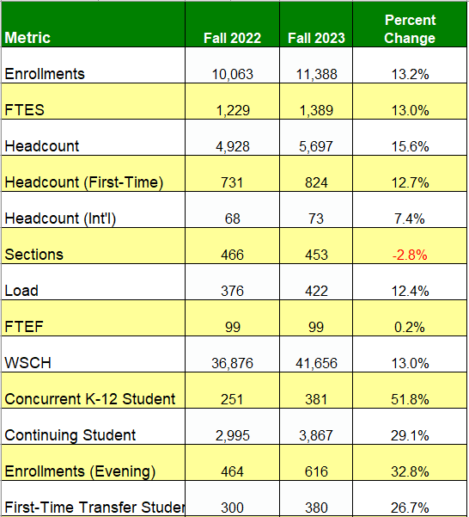
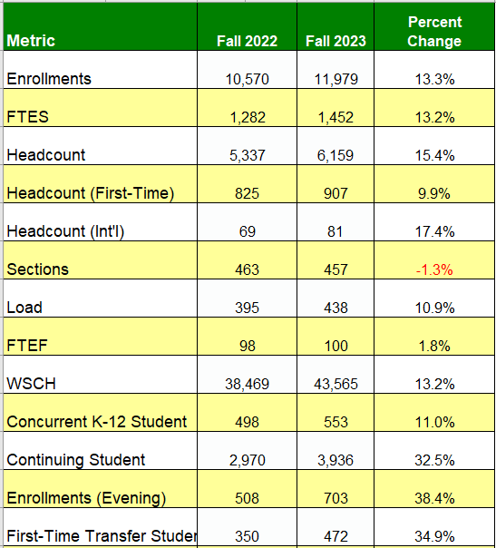
Point in Time Comparison—Compare last year this time
1st day of School
Census Day

Slide 6
Division Enrollment Metrics and Actual Information
Enrollment & Fill Rate by Division | Census Enrollment | Fill Rate | FTES | FTEF | Productivity Ratio | Load | Duplicated Section (CRN)
Bus. Design & Workforce (BDW) | 3,316 | 74% | 325.4 | 23.9 | 13.6 | 407.97 | 149
Counseling | 352 | 74% | 24.8 | 1.7 | 14.9 | 445.73 | 13
Humanities & Soc. Sci. (HSS) | 3,930 | 78% | 452.1 | 34.1 | 13.3 | 397.52 | 194
Kinesiology, Athl & Dan (KAD) | 1,033 | 66% | 124.6 | 8.0 | 15.6 | 469.29 | 113
Science & Technology (ST) | 3,164 | 81% | 514.9 | 31.5 | 16.3 | 490.02 | 117
Grand Total | 11,944 | 75% | 1450.1 | 99.4 | 14.6 | 437.49 | 586

Slide 7
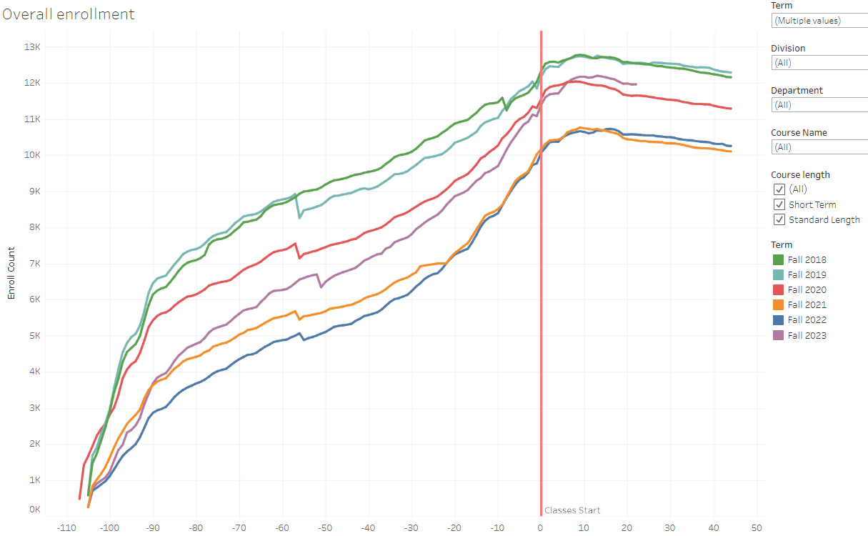
Enrollment Overall Trends (as of 9.10.2023)

Slide 8
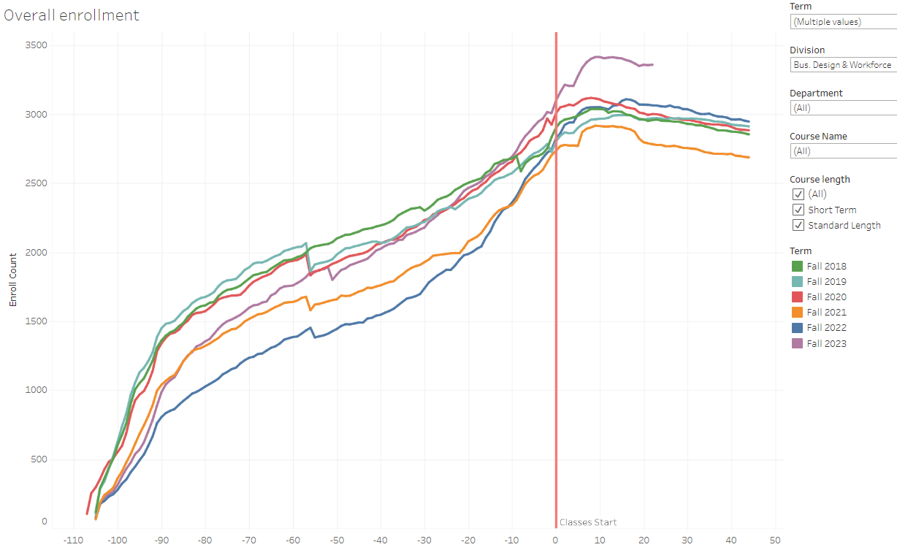
Business Design & Workforce

Slide 9
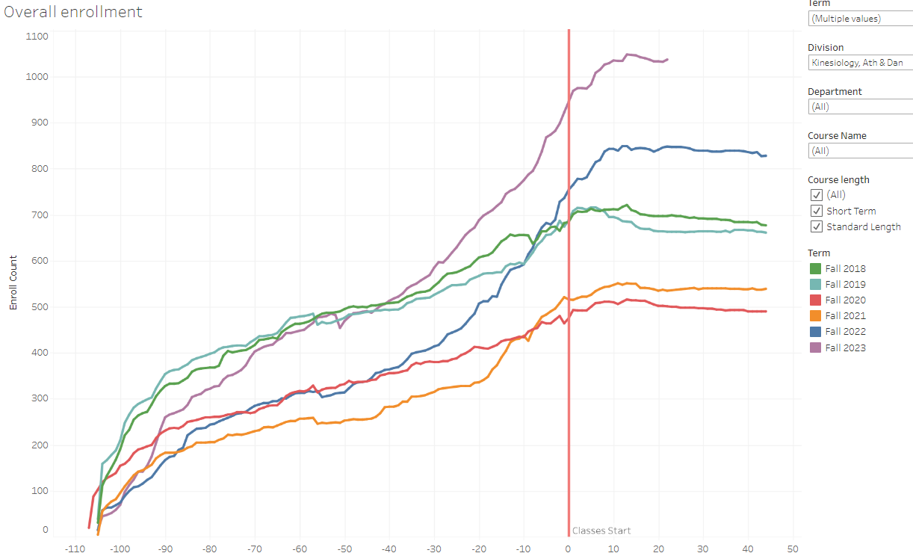
Kinesiology, Art, & Dance

Slide 10
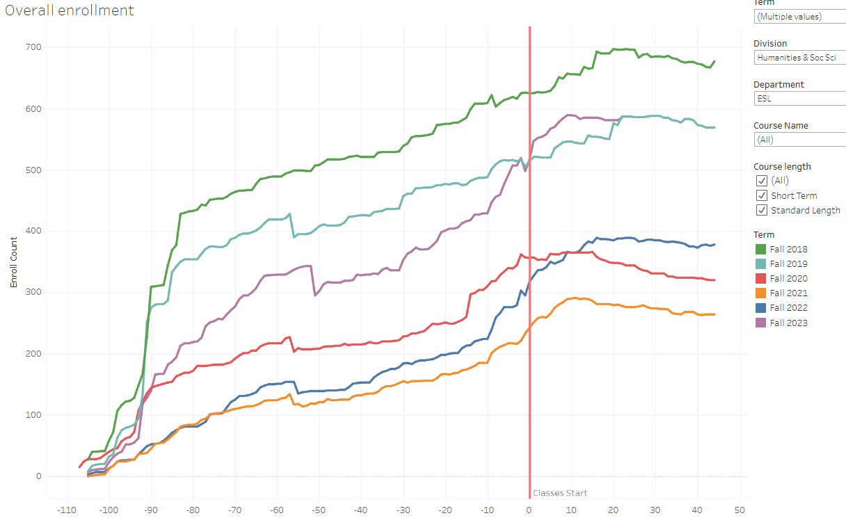
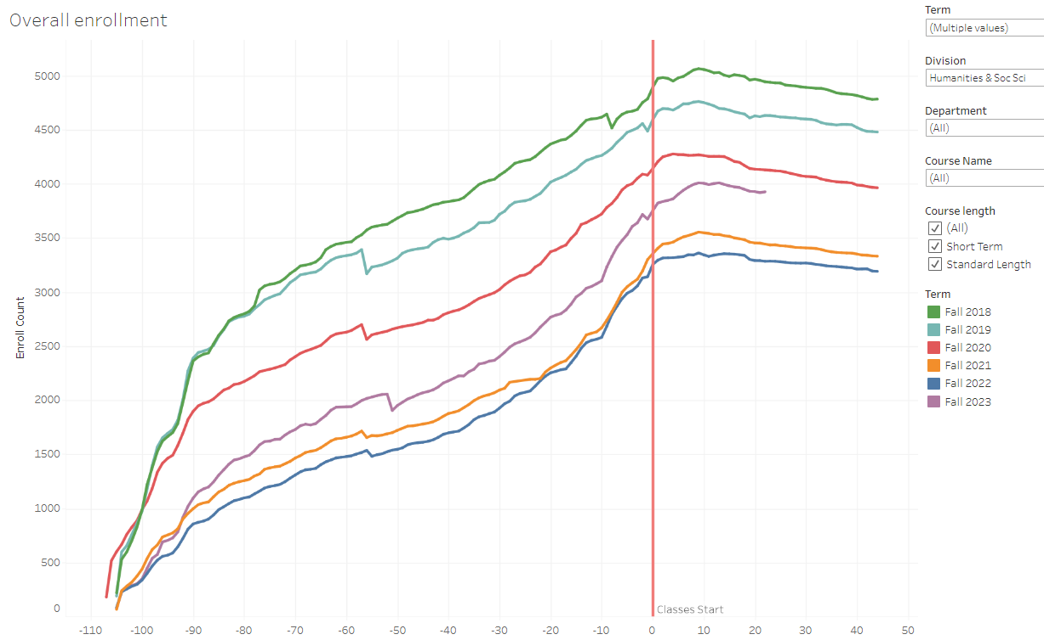
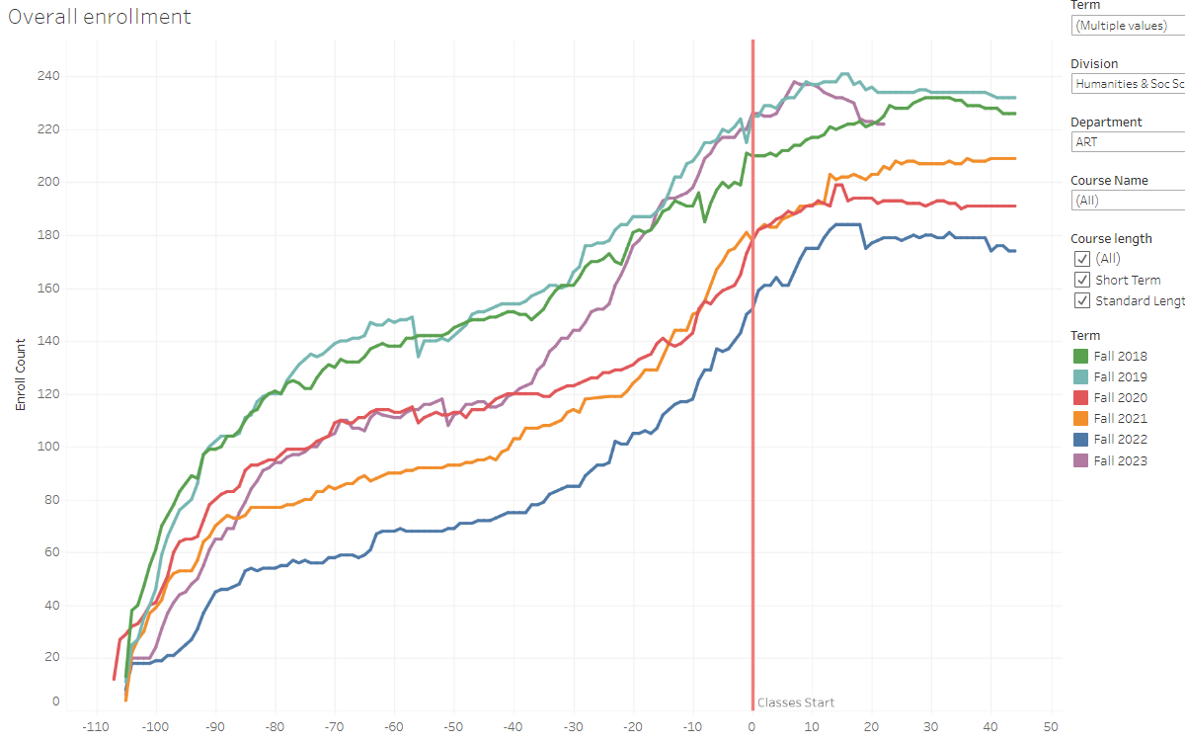
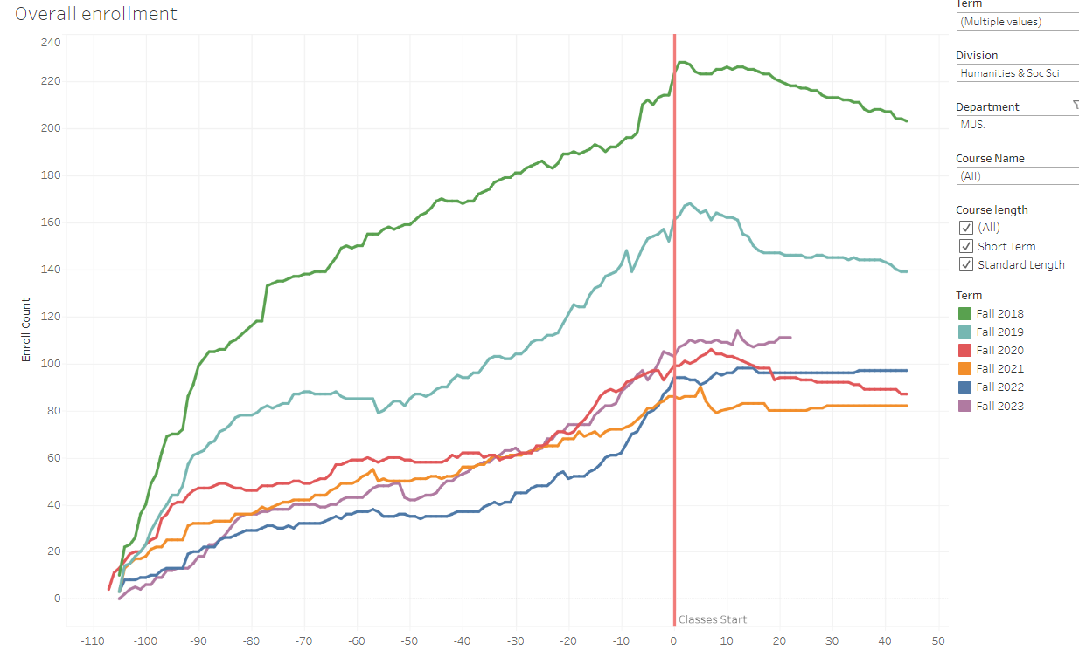
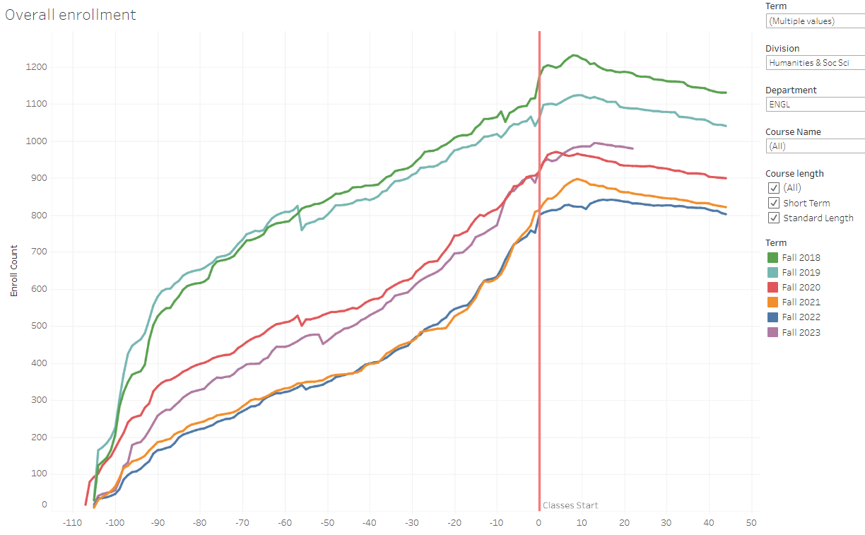
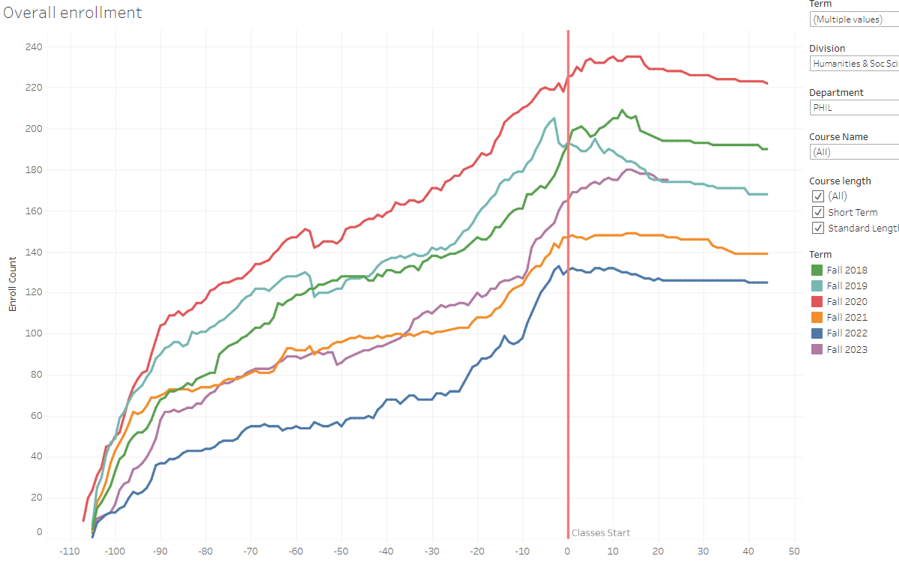
Humanities & Social Science

Slide 11
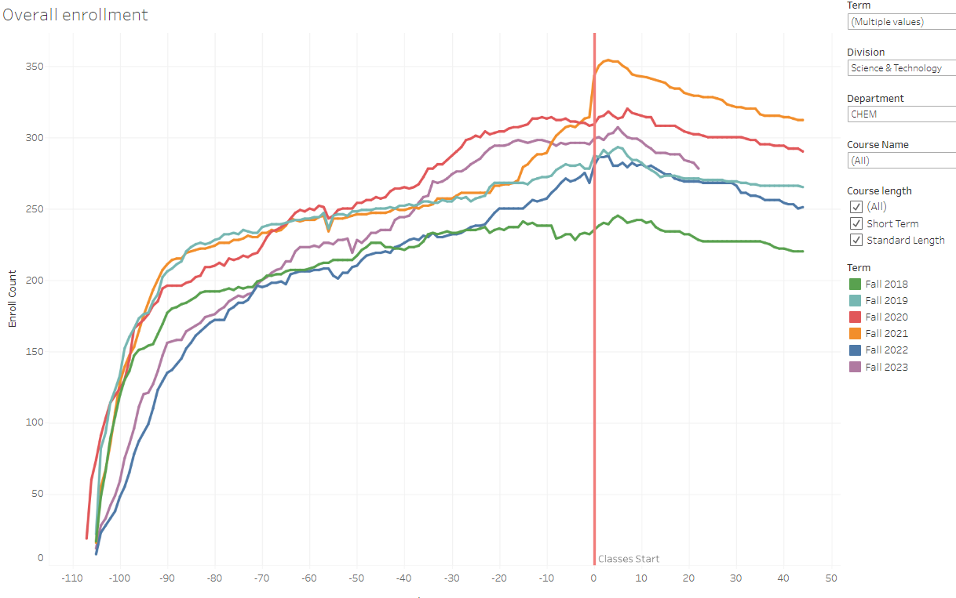
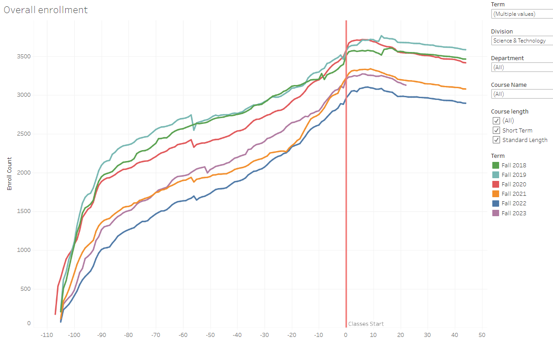
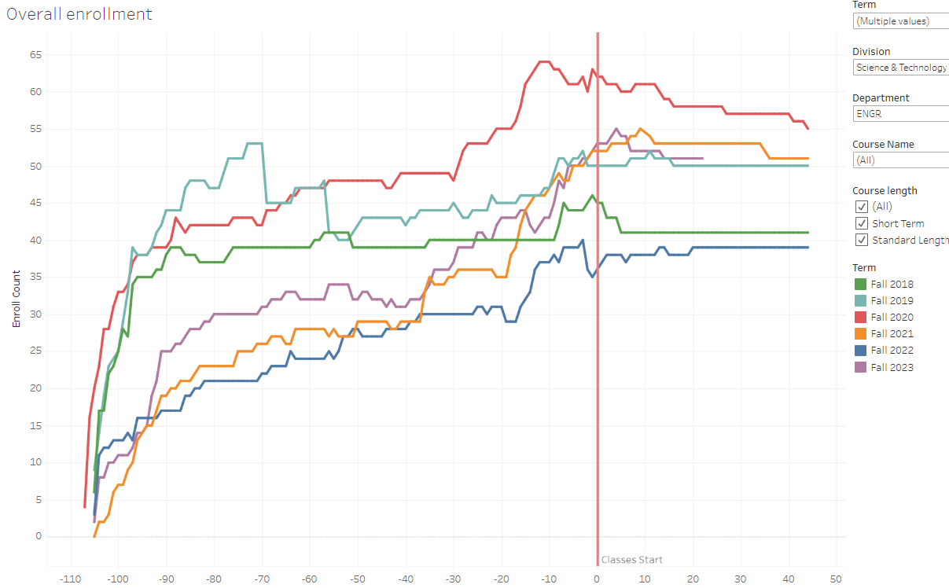
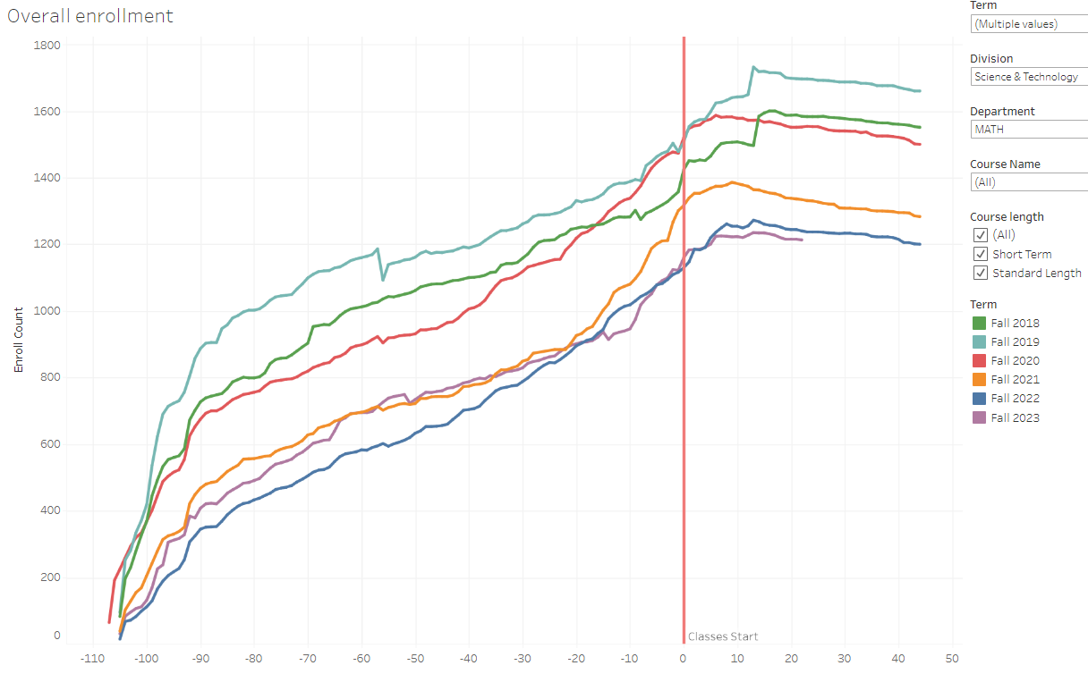
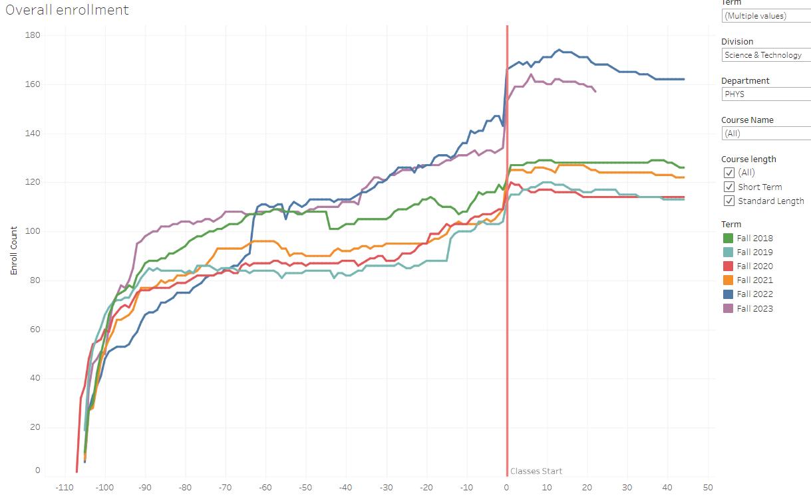
Science & Technology

Slide 12
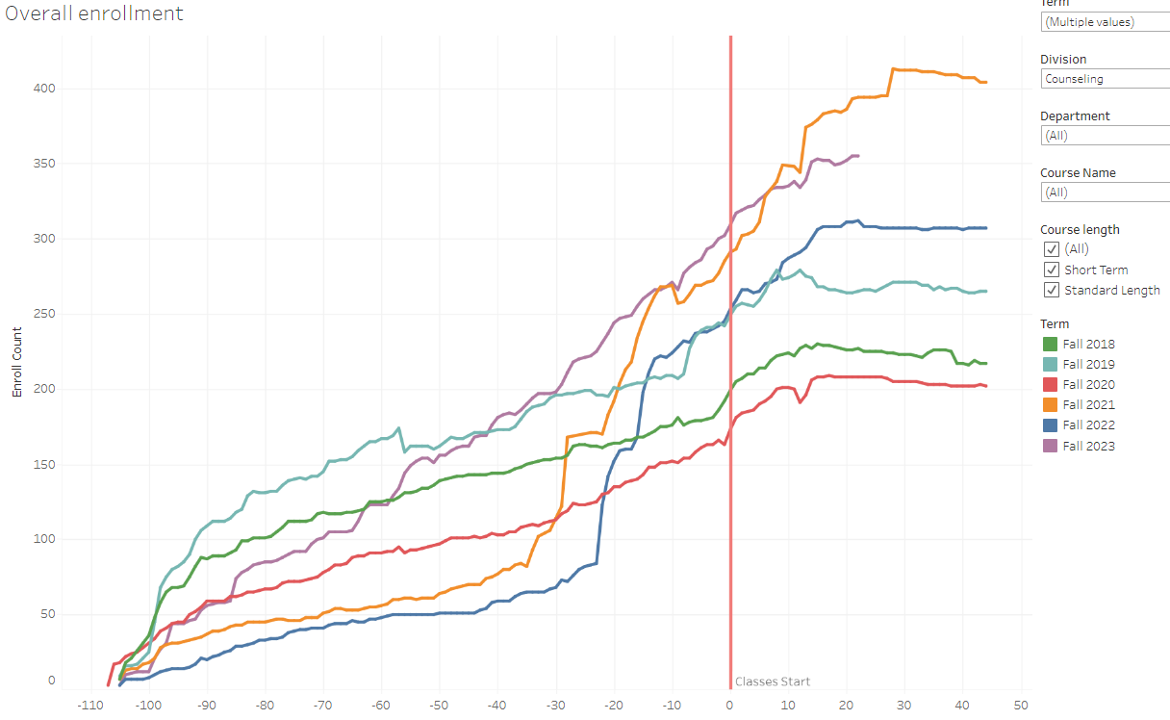
Counseling

Slide 13
Questions and Thoughts

