Slide 1
Annual Plan (draft) for implementing the College’s 5-year Education Master Plan 2024-25 Presented to the Planning & Budgeting Council on September 4, 2023

Slide 2
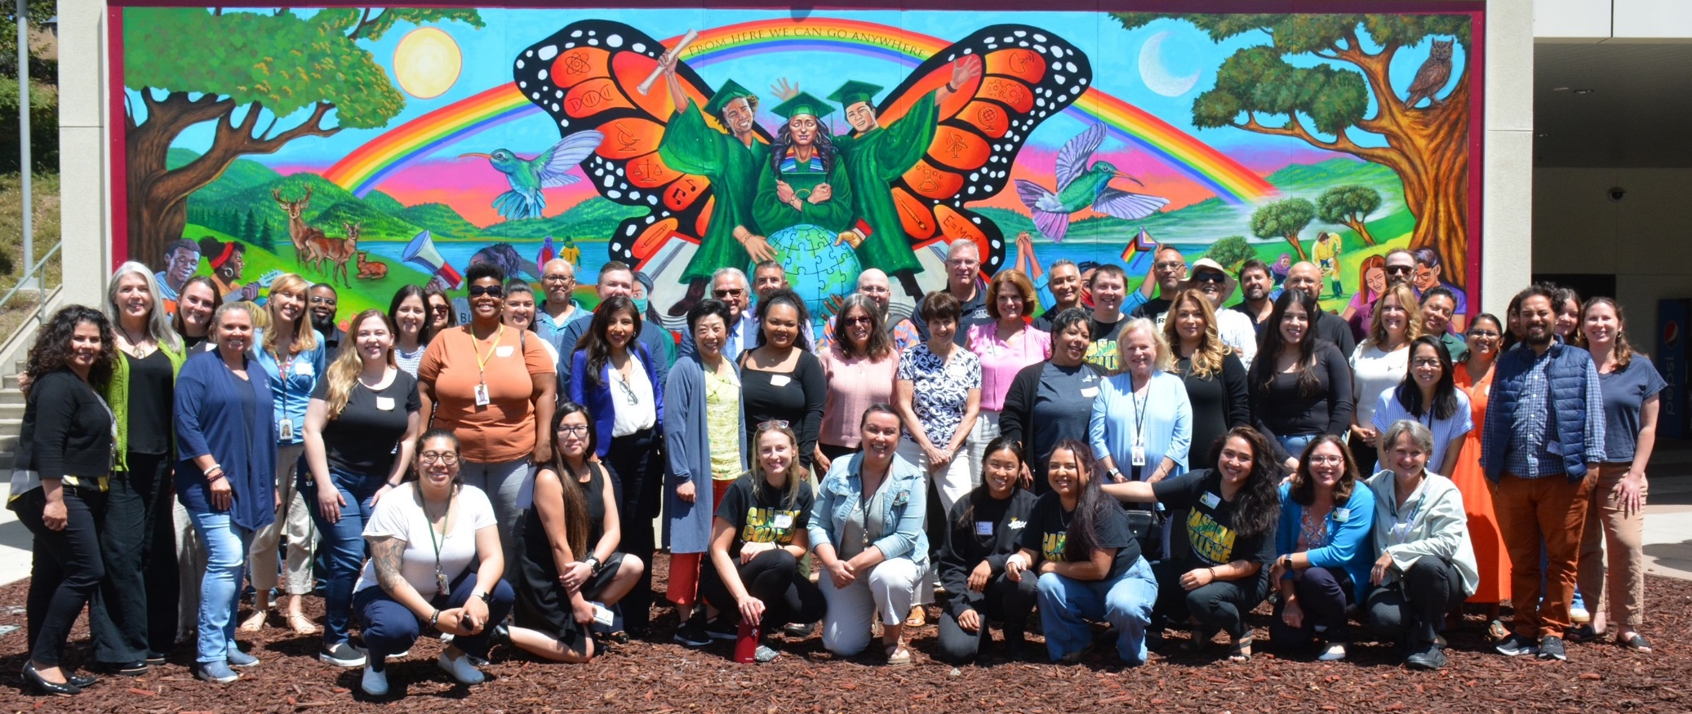
2024 Leadership Retreat Update
50+ students, faculty, classified staff and administrators participated
4 breakout sessions focused on choosing the top priorities for 2024-25
Check https://canadacollege.edu/plans/leadership-retreat.php for more info

Slide 3
GOAL 1: Student Success
Build on the CWA model & create a hub for evening students
Increase degree and certificate programs available in Menlo Park and East Palo Alto
Create and scale a First Year Experience Program
GOAL 2: Equity & Antiracism
Provide comprehensive on-boarding for all new employees
Transform college participatory governance processes
Evaluate academic support programs and practices
GOAL 3: Community Connections
Reach new community members in N. Fair Oaks, Belle Haven, and East Palo Alto, especially BIPOC communities
Strengthen transfer support services to increase transfers
Create and expand career exploration experiences for students
Double the number of alumni connected to Cañada’s Alumni Organization by 2027
GOAL 4: Infrastructure & Innovation
Improve access to campus via public transit, rideshare
Build a Childcare Center
Update and implement sustainability initiatives

Slide 4
Build on the CWA model & create a hub for evening students
EMP 1.2 Prioritize serving part-time, working students by building on the model of College for Working Adults (CWA). Add more degrees and certificates obtainable within 3 years via evening, weekend and online classes, and ensure adequate services are available in the evenings, to support at least 1,000 part-time students participating in CWA, particularly low income, BIPOC students, per term by 2027.
&
EMP 4.3 Create a hub for evening and weekend students to support their social connections, access to nutritional food and beverages, as well as learning support services (an Evening One Stop)
Lead(s)
James Carranza
Desired Outcomes
Inventory existing evening/online programs and services.
Timing
December, 2025 report recommendations to PBC
Wissem Bennani
Identify and market all evening/online programs
Ensure adequate evening services are offered
Mayra Arellano
Coordinate instructional and student services program for evening students
Complete marketing campaign by May, 2025
Kat Sullivan-Torrez
Megan Rodriguez-Antone
Jose Zelaya

Slide 5
Degree and Certificate Programs in Menlo Park and E. Palo Alto
EMP 1.4 Increase the number of degree and certificate programs and general education courses at the Menlo Park site and/or other off-campus locations (East Palo Alto) to help students access needed courses and support services closer to home.
Lead(s)
Alex Kramer
Desired Outcomes
Conduct an internal and external needs assessments
Timing
Assessments complete by December, 2024
Jasmine Jaciw
Identify programs and services to be offered
Mercedes White
Plan for future services in Menlo Park and EPA by May, 2024
Strategic plan for programs and services to be offered in EPA/Menlo Park

Slide 6
Create and scale a First Year Experience Program
EMP 1.15 Create (by 2023) and scale (by 2025) the First Year Experience program for all incoming students, including default course schedules for some first-time cohorts.
Lead(s)
Ron Andrade
Desired Outcomes
Timing
Inventory & Outline of desired FYE elements – Fall 2025
Max Hartman
Take inventory of current activities
Canada’s Retention and Early Alert Work Group (CREW)
Faculty (TBD)
Outline desired FYE elements
Identify gaps and opportunities to further FYE outcomes
Complete Gap analysis and develop FYE expansion plans
Gap analysis and expansion plans – Spring 2025

Slide 7
Provide comprehensive on-boarding for all new employees
EMP 2.7 Provide a comprehensive orientation and on-boarding for all newly hired faculty, staff and administrators each term that includes module(s) in antiracism shared language, resources for equitable pedagogy and practices, and how to connect with a mentor or personal support via the Cultural Center and/or Offices of Instruction, Student Services, and Administrative Services.
Lead(s)
Anniqua Rana
Desired Outcomes
Enhance existing orientation with antiracism
Timing
Enhanced orientation in place by May, 2025
Michiko Kealoha
Professional Development Planning Committee (PDPC)
Provide on-going onboarding for new employees

Slide 8
Transform college participatory processes
EMP 2.10 Reimagine and transform college participatory governance processes and structures to: (1) address equity and antiracism in all integrated planning and resource allocation decisions; (2) increase student voice in college processes, including program review; and (3) ensure classified staff have adequate time to contribute to the committees and councils on which they serve.
Lead(s)
Michiko Kealoha
Desired Outcomes
Ensure all student survey (CCSSE, PTK, Graduation) data are given to Councils, Committees, and programs who are in a position to take action in response.
Timing
Survey data out by December, 2024
Gampi Shankar
Alex Claxton
Karen Engel
Support academic and student support services who are incorporating student voice in program assessments via student surveys to assess their Service Area Outcomes (SAOs)
SAO’s assessed by May, 2024
Classified Senate will present committee and council assignments and openings to managers to College Council at its first meeting in Fall 2024 in order to better support classified representation and participation.
Classified Staff committee and council representatives available early Fall 2024

Slide 9
Evaluate academic support programs and practices
Lead(s)
Karen Engel
Desired Outcomes
Complete a 2nd evaluation of Interest Area Success Teams
Timing
May 2025
Ron Andrade
Complete a more in-depth evaluation of Tutoring, Instructional Aide support, and the STEM/Writing centers
EMP 2.14 Regularly evaluate all academic support programs and practices to ensure they are effective in closing equity gaps in access, student success and completion. These include but are not limited to: Interest Area Success Teams, the Learning Center, Tutoring (online and in person), the Writing Center, and Peer Mentoring, Library, Math, Word and all other JAMS.
Notes:
Include Instructional Aides that report to Deans Carranza and Thompson. Evening student support should be seamless, so ensure we include CWA folks in this work. DRC has Instructional Aides – be sure to include them.

Slide 10
Reach new community members in N. Fair Oaks, Belle Haven, and East Palo Alto, especially BIPOC communities
EMP 3.2 Transform where we share what Cañada has to offer by identifying and reaching new outreach audiences that help strengthen our ties to BIPOC communities (particularly those communities our recruitment maps indicate might be underserved, such as North Fair Oaks, Belle Haven, and East Palo Alto).Recruit more BIPOC students, including more students who identify as Black/African American.
Lead(s)
Wissem Bennani
Desired Outcomes
Host listening sessions in EPA and Belle Haven
Timing
Complete listening sessions by December, 2024
Identify new partners in N. Fair Oaks, Belle Haven and EPA
Recommendations for future actions to PBC by spring 2025
EMP 3.2 Group

Slide 11
Strengthen transfer support services
EMP 3.8 Strengthen transfer support services by, (1) building University pathways and expanding the University Center, (2) increasing by 35% the number of Cañada College transfer-seeking students who achieve transfer readiness and the number of students who apply to a 4-year University ­­­between 2022 and 2027 (adjusted for enrollment fluctuations) and, (3) reduce transfer equity gap for low-income, first generation, and Black, Indigenous, and People of Color (BIPOC) students.
Lead(s)
Max Hartman
Desired Outcomes
Evaluate the 2021-2024 Transfer Plan
Timing
Evaluation completed by December, 2024
Develop a new Transfer Center Plan for 2024-27
New Transfer Plan completed by May 2025
Gonzalo Arrizon
Mary Ho
Alex Claxton
Honors, PTK, MESA leads

Slide 12
Create and expand career exploration experiences for students
EMP 3.11 Create and expand career exploration experiences (such as work-based learning, internships, and job shadow opportunities) for students during their time at Cañada, particularly during their First Year (in each Interest Area), as they choose a program of study and refine their education goals. Close racial equity gaps in access to career development and job placement opportunities.
Lead(s)
Alex Kramer
Desired Outcomes
Timing
Begin to scale Speakers Series: December 2025
Ron Andrade
Bob Haick
Ramki Kalyanaraman
Rance Bobo (MESA)
Explore job board options that help students find positions aligned with their field of study
Expand the Career Exploration Speakers Series and align it with specific Interest Areas
Broaden communication channels to enhance student engagement in career exploration activities
Track engagement: October 2024 - May 2025
Explore job board options: May 2025
Strengthen partnerships with regional employers to align programs with workforce needs
Strengthen partnerships: Ongoing

Slide 13
Double the number of alumni connected
EMP 3.12 Strengthen the emerging Cañada College alumni organization by doubling the number of alumni connected to it by 2027, as well as involving more of them in campus activities that strengthen the campus as a center of community life, provide career exploration for existing students, and develop new resources and connections for the College.
Lead(s)
Megan Rodriguez Antone
Desired Outcomes
Build alumni database by connecting with alumni through LinkedIn, college programs and Commencement events
Timing
December 2024: research platforms and build alumni database
June 2025: recruit alumni to sign up for database
Campus partners:
Programs with existing alumni connections (Athletics, BDW, Student Life, STEM, etc.)

Slide 14
Improve access to campus
Lead(s)
Ludmila Prisecar
Desired Outcomes
Analyze the existing current Lyft Pilot Program
Timing
November 2024: complete analysis and present recommendations re Lyft to PBC
Wissem Bennani
Implement the SamTrans grant (5,000 bus passes)
Marketing campaign for SamTrans bus passes in place by October, 2024
EMP 4.1 Improve access to campus via public transit, shuttles, and additional partners such as Lyft and Cruise.

Slide 15
Build a Childcare Center
Lead(s)
Chialin Hsieh
Desired Outcomes
Establish timeline for building and staffing the CDC
Timing
Timeline completed by October, 2024
Alex Kramer
EMP 4.2 Build student housing on campus, as well as a Childcare Center to serve students with families.

Slide 16
Update and implement sustainability initiatives
Lead(s)
Ludmila Prisecar
Desired Outcomes
Inventory current initiatives
Timing
Share inventory with PBC, Fall 2024
Susan Mahoney
Karen Pinkham
EMP 4.9 Update and implement the College and District sustainability initiatives in response to climate change to reduce the environmental impact of campus-based activities while ensuring uninterrupted, quality instruction at all times.

